Slide 1
Unit 9 Have you ever been to a museum?
Section A 1a-2d
R·八年级下册

Slide 2
Learning objects
By the end of the class, you will be able to …
1. Learn curriculum words and useful expressions.
2. Talk about past experiences with the key sentence
patterns.
3. Know some famous museums and theme parks
and share something interesting with classmates.

Slide 3
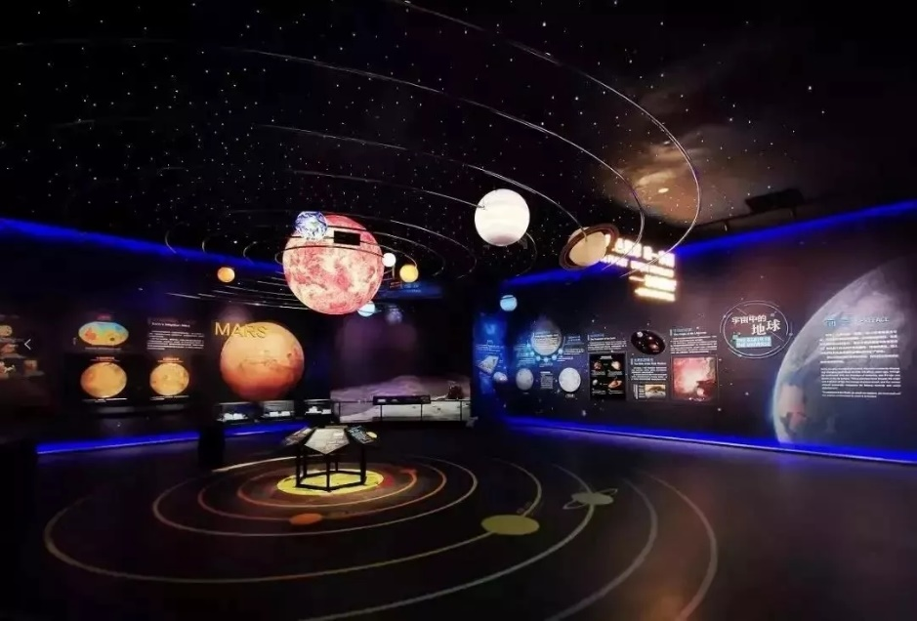
Free Talk
Where did you go on vacation?
Have you ever been to a/an …?
space museum
I went to a space museum.
I have been to a space museum.

Slide 4
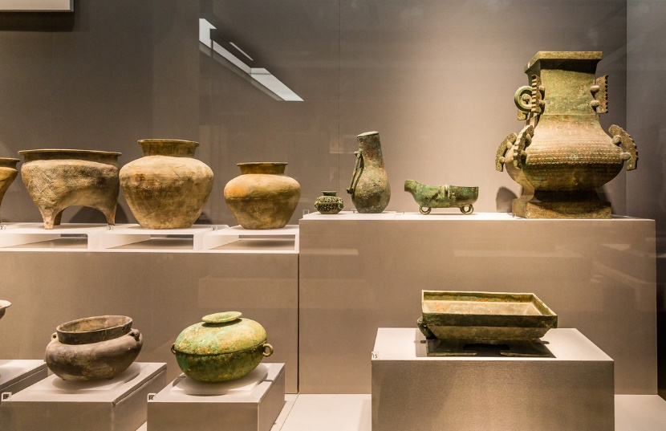
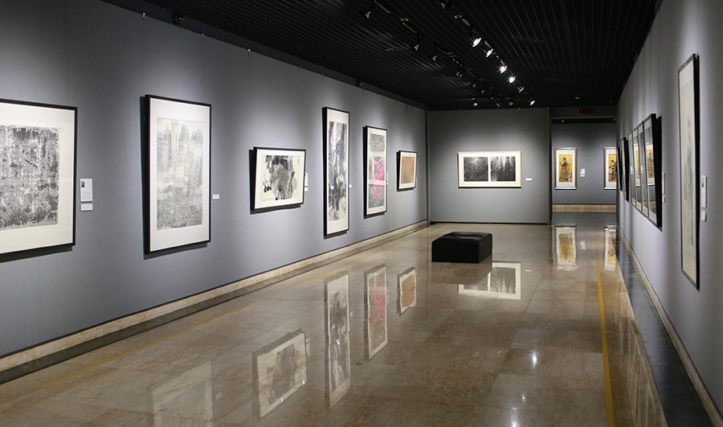
I went to an art museum.
I have been to an art museum.
art museum
history museum
I went to a history museum.
I have been to a history museum.

Slide 5
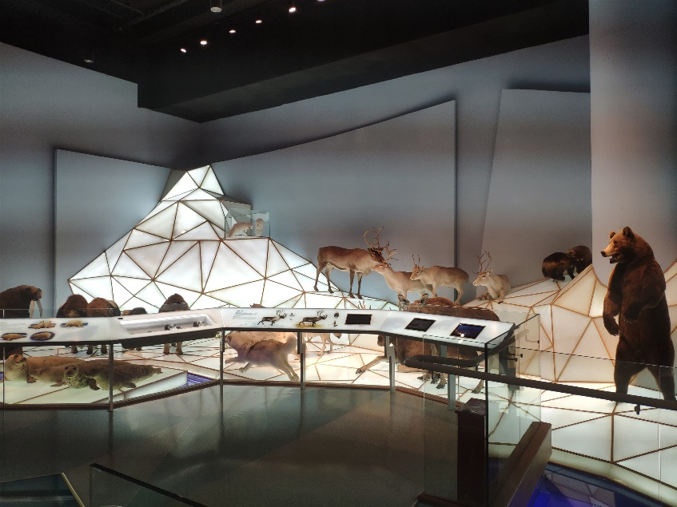
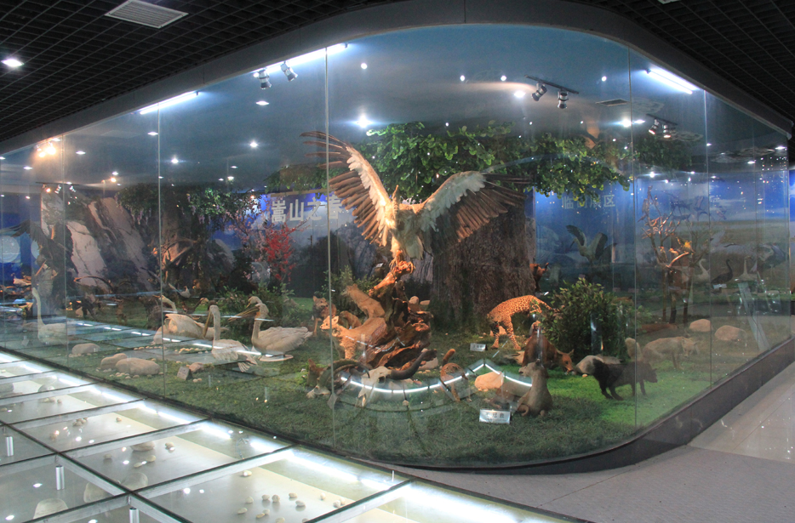
I went to a/an __________.
I have been to a/an __________.
science museum
nature museum

Slide 6
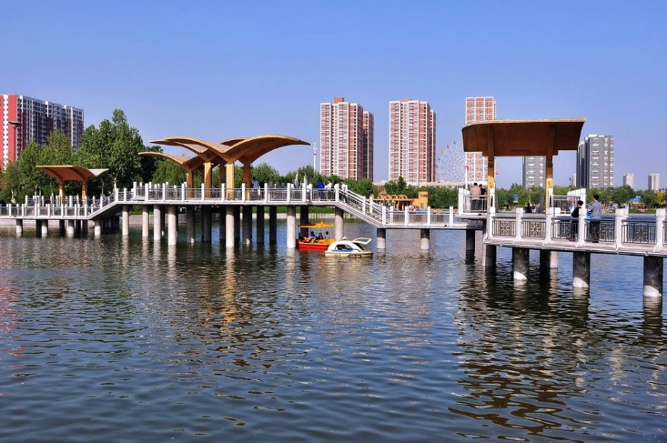
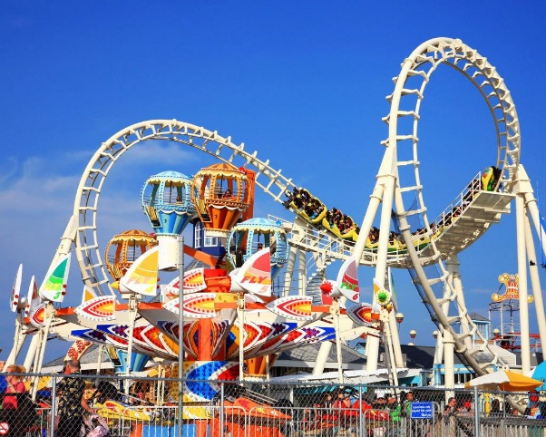
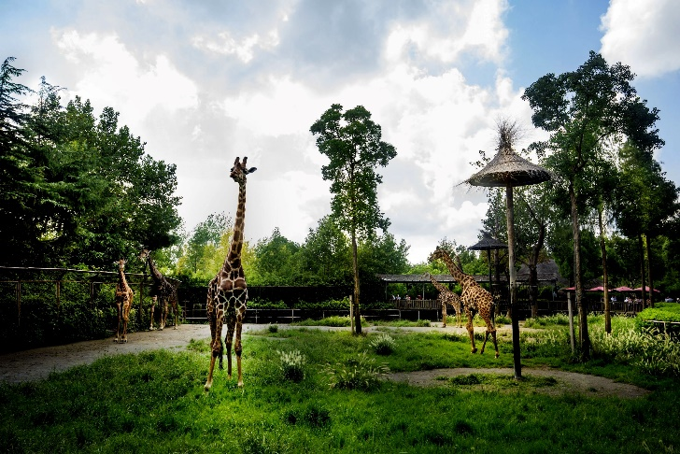
amusement n. 娱乐；游戏
amusement park
游乐场
water park
zoo

Slide 7
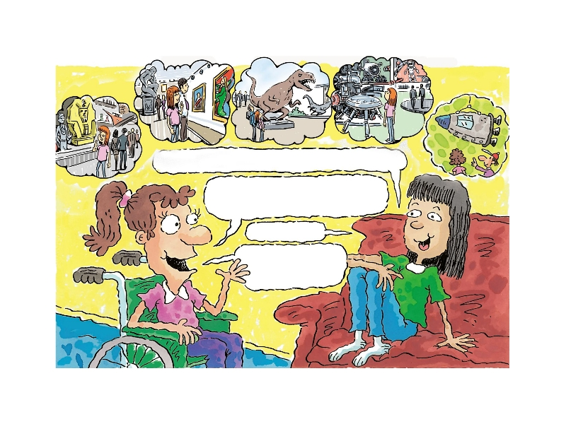
Look and say
What places can you see in the picture?
art museum
science museum
space museum
history museum

Slide 8
Memory challenge
Do you still remember these places?
2
3
1
5
4

Slide 9
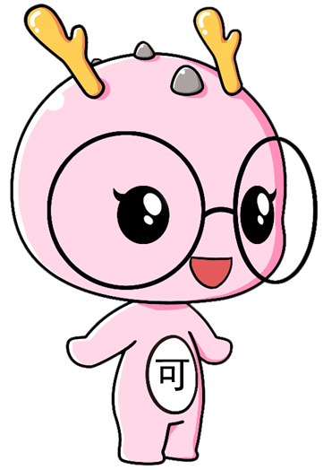
Which of these places would you like to visit? Rank them from 1 (most) to 6 (least).
1a
Where do you think is the most interesting place and why?
space museum ____ history museum ____
art museum ____ water park ____
zoo ____ amusement park ____

Slide 10

have been to … 去过……
Listen. Have these students ever been to these places? Check（✔）the boxes.
1b
 | Science museum | History museum | Art museum | Nature museum | Space museum
Claudia
Sarah
✔
✔
✔
✔
✔
✔

Slide 11
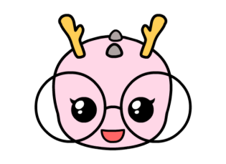
Let’s say
 | Science museum | History museum | Art museum | Nature museum | Space museum
Claudia
Sarah
✔
✔
✔
✔
✔
✔
Claudia/Sarah (never) has been to an art museum/...

Slide 12
Listen again and answer
When did Sarah go to the National Science Museum?
Last year.
Has Sarah been to a history museum?
No, she hasn’t.
What does Claudia say about history?
She is not interested in history.

Slide 13
Listening material
Sarah: I’m bored, Claudia. Let’s do something
interesting.
Claudia: Have you ever been to a science museum?
Sarah: Yes, I have. I went to the National Science
Museum last year. Have you ever been to a
history museum?
Claudia: No, I haven’t.
Sarah: Me neither. Let’s go to one tomorrow.
Me neither.常用于口语中，意为“我也没/不……”，此处相当于“Neither/Nor have I.”，与Me too 相对应。

Slide 14
Claudia: Well, that sounds good, but I’m not interested
in history.
Sarah: Really? I didn’t know that. Well, how about the
art museum? Have you been to the art museum?
Claudia: I’ve been to the art museum many times.
Sarah: Me, too. But I’d like to go again. Hmm, let’s
see… how about the nature museum? I’ve been
there a few times.

Slide 15
Claudia: So have I. I went there on our last school trip.
Sarah: I know. Let’s go to the space museum. I’ve
never been there.
Claudia: That’s a great idea. I went there last year,
but I’d like to go there again.

Slide 16
1c
Ask and answer questions about the
places in 1b.
Somewhere通常用于肯定句中，在否定句或疑问句中要用anywhere。形容词修饰somewhere, anywhere等时，应置于其后。
A: Let’s go somewhere different today.
B: OK. Where do you want to go?
A: Have you ever been to the space museum?
B: No, I haven’t. How about you?
A: …

Slide 17
Make a dialogue
For example
Let’s go somewhere different today.
OK. Where do you want to go?
Have you ever been to …?
Yes/No, I have/haven’t. How about you?
Me, too./Me neither. Let’s go to one tomorrow.
Well, that sounds good. But I …

Slide 18
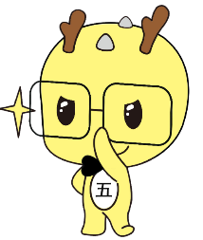
Chain game
Group competition: Tell the class what museum you have been to like the following way. The group that spends the least time is the winner.
A: I have been to a history museum.
B: A has been to a history museum. I have been to a science
museum.
C: A has been to a history museum. B has been to a science
museum. I have been to …
D: …
Which group will be the winner?

Slide 19
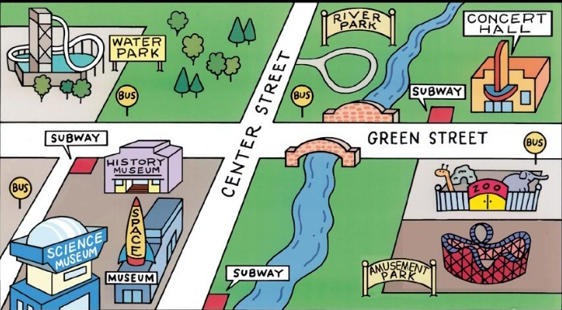
Look and say
Where is the space museum/amusement park/ water park?
How can we get there?

Slide 20
Look at the map of the town. Listen
and circle the places you hear.
2a

Slide 21
2b
Listen again and circle T for true or F for false.
Conversation 1
1. Tina went to the space museum last year. T / F 2. John has never been to the space museum. T / F 3. They are going to take the subway. T / F

Slide 22
Conversation 2
1. Linda has been to the amusement park. T / F 2. Linda went to the amusement park yesterday. T / F 3. Linda is going to the amusement park again by bike. T / F

Slide 23
Conversation 3
1. Frank had a great time at the water park. T / F 2. Frank’s friend has never been to the water park. T / F 3. Frank and his friend are going skating. T / F

Slide 24
Listen again and correct the false statements
Conversation 2
1. Linda has been to the amusement park. 2. Linda went to the amusement park yesterday. 3. Linda is going to the amusement park again by bike.
a long time ago

Slide 25
Conversation 3
1. Frank had a great time at the water park. 2. Frank’s friend has never been to the water park. 3. Frank and his friend are going skating.
has never been to

Slide 26
Listening material
Conversation 1
John: Hey, have you ever visited the space museum, Tina?
Tina: Yes, I went there last year. Have you ever been
there, John?
John: No, I haven’t.
Tina: Well, I’d really like to go there again.
John: Great. What bus do we take to get to the museum?
Tina: We can take the subway. The station is near the
museum.

Slide 27
Conversation 2
Kim: Hi, Linda. Have you ever been to the amusement
park?
Linda: Yes, I have, but a long time ago. I remember it was
really fun. There were so many exciting things to
do there.
Kim: Do you want to go again next week?
Linda: Sure. I think that would be a great idea.
Kim: Do you think we can ride our bikes there?
Linda: Of course! It’s not very far away. It’s just on
Green Street, behind the zoo.

Slide 28
Conversation 3
Tom: Have you ever been to the water park, Frank?
Frank: No, I’ve never been there.
Tom: Neither have I. Let’s go there together!
Frank: I’d really love to go, but I don’t have any money.
Tom: Well, let’s go skating instead. There’s a great new
place for skating in River Park on Center Street.
Frank: That’s a great idea. Could I borrow your bike? I
want to go home to get my skates.

Slide 29
Look at the map in 2a and make conversations about the places.
2c
A: Have you ever been to the space museum?
B: Yes, I have. How about you?
A: No, I haven’t.
B: Oh, it’s fantastic. Let’s go tomorrow.
A: OK. How are we going to get there?
B: We can take the subway.

Slide 30
Make a dialogue
You can use these sentence patterns:
I’d really like to go there again.
What bus do we take to get to …?
There are so many … things to do there.
Neither have I.
Let’s go … instead.
There’s a great new place for …

Slide 31
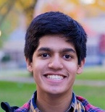
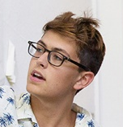
Hello, have you ever been to the amusement park?
Yes, I have and I really like to go there again.
How about going there tomorrow?
OK. There are so many interesting things to do there.
…

Slide 32
Read the dialogue in 2d and answer
When did Jill go to the film museum?
What does Jill love about the film museum?
What did Jill learn about?
Who did Jill camp with on the weekend?
Has Anna ever been camping?

Slide 33
Check answers.
When did Jill go to the film museum?
In April.
What does Jill love about the film museum?
She loves all the old movie cameras there.
What did Jill learn about?
She learned about the inventions that led
to color movies.

Slide 34
Who did Jill camp with on the weekend?
With her friends.
Has Anna ever been camping?
No, she hasn’t.

Slide 35
2d
Role-play the conversation.
Anna: I went to the film museum last weekend.
Have you ever been there?
Jill: Yes, I have. I went there back in April.
Anna: It’s really interesting, isn’t it? It’s a great
way to spend a Saturday afternoon.
Jill: Yes, I love all the old movie cameras
there. I learned about the inventions
that led to color movies, too.
反意疑问句：由“陈述部分+附加疑问部分”构成。附加疑问部分常译为“是不是？/不是吗？/是吧？/对吧？”。
与learn of 同义，意为“了解；获知；得知”，其后接所获知的具体内容。
lead to意为“通向；导致；把……带到”。to为介词，其后接名词或动词-ing形式。
发明；发明物

Slide 36
Anna: So, what did you do on the weekend?
Jill: I camped in the mountains with some
friends. We put up a tent and cooked
outside.
Anna: That sounds fun. I’ve never been camping.
Jill: You should try it!
现在完成进行时：表示某动作从过去某个时间开始，一直延续到现在，并且还有可能继续下去。
结构：have/has been +现在分词

Slide 37
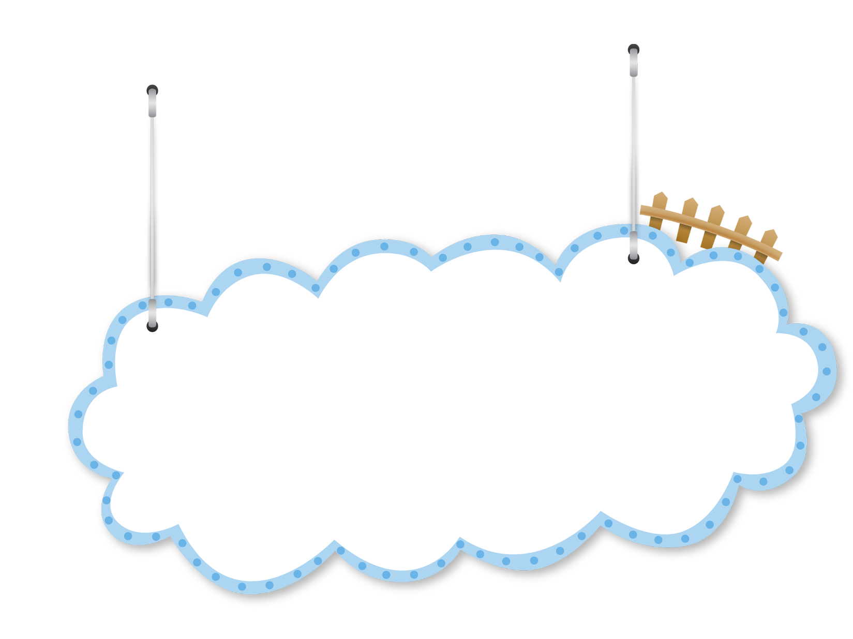
Let’s read
Anna: I went to the film museum last weekend.
Have you ever been there?
Jill: Yes, I have. I went there back in April.
Anna: It’s really interesting, isn’t it? It’s a great
way to spend a Saturday afternoon.
Jill: Yes, I love all the old movie cameras
there. I learned about the inventions
that led to color movies, too.
Read after the tape to imitate the pronunciation and intonation.
Read in roles.
Act out the dialogue in front of the class.

Slide 38
Anna: So, what did you do on the weekend?
Jill: I camped in the mountains with some
friends. We put up a tent and cooked
outside.
Anna: That sounds fun. I’ve never been camping.
Jill: You should try it!

Slide 39
Let’s fill and retell
Anna went to the film museum ____________. She thinks the film museum is really ___________. She has _____ been camping. Jill went to the film museum in ______. She loves all the old movie cameras, and she learned about the inventions that led to ____________. On the weekend, Jill _________ in the mountains with some friends.
last weekend
interesting
never
April
color movies
camped

Slide 40
Summary
Some places:
space museum history museum art museum
water park zoo amusement park
Key sentence patterns:
— Have you ever been to …?
— Yes/No, I have/haven’t.

Slide 41
Homework
Recite the dialogue in 2d.
Share the most interesting museum with your friends.
Do the exercises.（见“状元成才路”系列丛书《创优作业》对应课时作业）

