Slide 1
Lesson 109
A good idea

Slide 2
New Words and expressions
idea /aɪˈdɪə/ n. 主意
a little 少许 (用于不可数名词之前)
teaspoonful /ˈtiːˌspuːnful/ n. 一满茶匙
less /les/ adj. (little的比较级)较少的，
更小的
a few /ə fjuː/几个(用于可数名词之前)
pity /ˈpɪti/ n. 遗憾
instead /ɪnˈsted/ adv. 代替
advice /ədˈvaɪs/ n. 建议，忠告

Slide 3

idea
idea /aɪˈdɪə/ n. 主意
have an idea 有一个主意

Slide 4
a little
little /ˈlɪtl/ adj. 小的 adv. 不多，少量
a little 少许 (用于不可数名词之前)
a little juice 一点果汁

Slide 5
less
less /les/ adj. (little的比较级)较少的，更小的

Slide 6
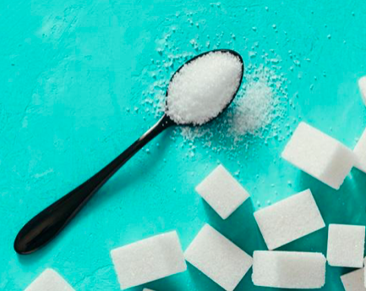
teaspoonful
teaspoon /ˈtiːˌspuːnful/ 茶匙
teaspoonful /ˈtiːˌspuːnful/ n. 一满茶匙

Slide 7
a few
a few /ə fjuː/几个(用于可数名词之前)
E.g. There are a few students in the classroom. 教室里有几个学生。
few /fju:/ pron. 很少的，几乎没有的
E.g. few seats were left. 只剩下很少的座位了。
Notes:
参考：few的的短语?(精选6条)-语录网 www.chinansn.com

Slide 8
pity
pity /ˈpɪti/ n. 遗憾
What a pity! 真遗憾。
英语中常用“What a + 可数名词”和“what + 不可数名词”的结构表示感叹。

Slide 9
instead
instead /ɪnˈsted/ adv. 代替
instead of 而不是, 代替
E.g. They went to the restaurant for dinner instead of eating at home.
他们去餐厅吃饭了，而不是在家。

Slide 10
advice
advice /ədˈvaɪs/ n. 建议，忠告
a piece of advice 一条建议
give advice 提出忠告
take advice 听取意见

Slide 11
Listen and answer the question:
What does Jane have with her coffee?

Slide 12
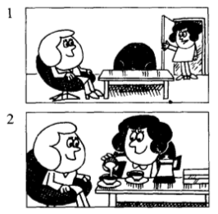
CHARLOTTE: Shall I make some coffee, Jane?
JANE: That’s a good idea, Charlotte.
CHARLOTTE: It’s ready.
Do you want any milk?
JANE: Just a little, please.

Slide 13
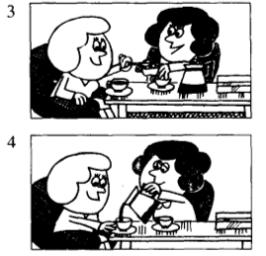
CHARLOTTE: What about some sugar?
Two teaspoonfuls?
JANE: No, less than that.
One and a half teaspoonfuls, please.
That’s enough for me.
JANE: That was very nice.
CHARLOTTE: Would you like some more?
JANE: Yes, please.
less than that, 意思是“比那稍微少一些”，其中的that指上文中的teaspoonfuls。

Slide 14
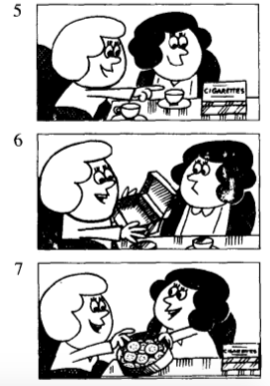
JANE: I’d like a cigarette, too. May I have one?
CHARLOTTE: Of course.
I think there are a few in that box.
JANE: I’m afraid it’s enough.
CHARLOTTE: What a pity!
JANE: It doesn’t matter.
CHARLOTTE: Have a biscuit instead. Eat more and smoke less!
JANE: That’s very good advice!
I’d = I would; I’d like…, 我想要……。

Slide 15
夏洛特：我来煮点咖啡好吗，简？
简：这是个好主意，夏洛特。
夏洛特：加些糖怎么样？两茶匙行吗？
简：不，再少一些。请放一勺儿半。那对我已足够了。
简：太好了。
夏洛特：你再来点吗？
简：好的，请再来一点。
简：我还想抽枝烟。可以给我一枝吗？
夏洛特：当然可以。我想那个盒子里有一些。
简：恐怕盒子是空的。
夏洛特：真遗憾！
简：没关系。
夏洛特：那就吃块饼干吧。多吃点，少抽点！
简：这是极好的忠告啊！
参考译文

Slide 16
Role-play

Slide 17
Lesson 110
How do they compare?

Slide 18
New Words and expressions
most /məust/ adj. (many, much的最高级)最多的
least /liːst/ adj. (little的最高级)最小的，最少的
best /best/ adj. (good的最高级) 最好的
worse /wɜːs/ adj. (bad的比较级)更坏的
worst /wɜːst/ adj. (bad的最高级)最坏的

Slide 19
Practice: 填写形容词和副词的比较级和最高级
many, much （ ）（ ）
little （ ）（ ）
good （ ）（ ）
bad （ ）（ ）
more
most
less
least
better
best
worse
worst

Slide 20
Complete these sentences using much, many, less or fewer
完成以下句子，用much, many, less或fewer填空
I haven’t got any pens. I haven’t got _______ either.
I’ve got some money. I’ve got _______ than you have.
I haven’t got any money. I haven’t got ________ either.
I’ve got some books. I’ve got __________ than you have.
many
less
much
fewer

Slide 21
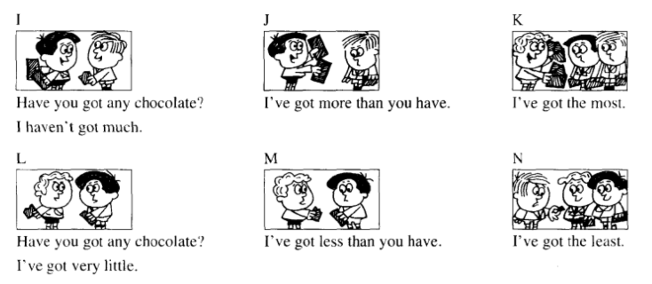
How do they compare?

Slide 22
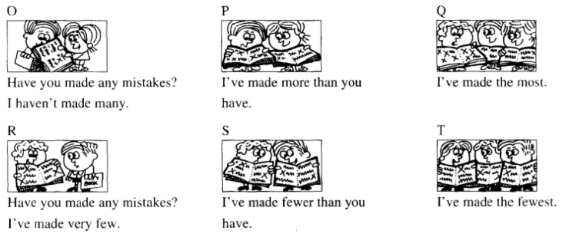
How do they compare?

Slide 23
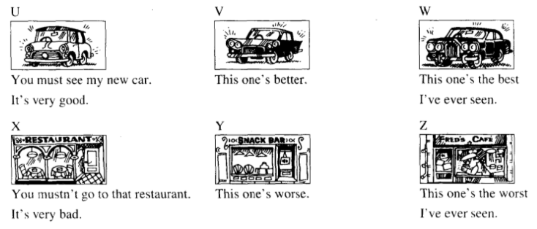
How do they compare?

Slide 24

Homework
1. 抄写单词3遍，完成课后习题
2. 练习L109课文对话

