Slide 1
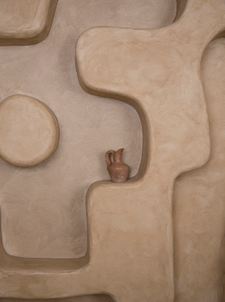


design concept | 11.14.2020
INVSON应尚服饰

Slide 2
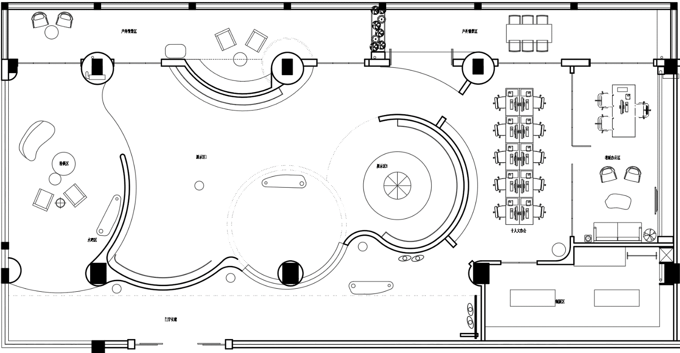

CONCEPT |平面方案PROPOSED LAYOUT
INVSON应尚
浙江

Slide 3
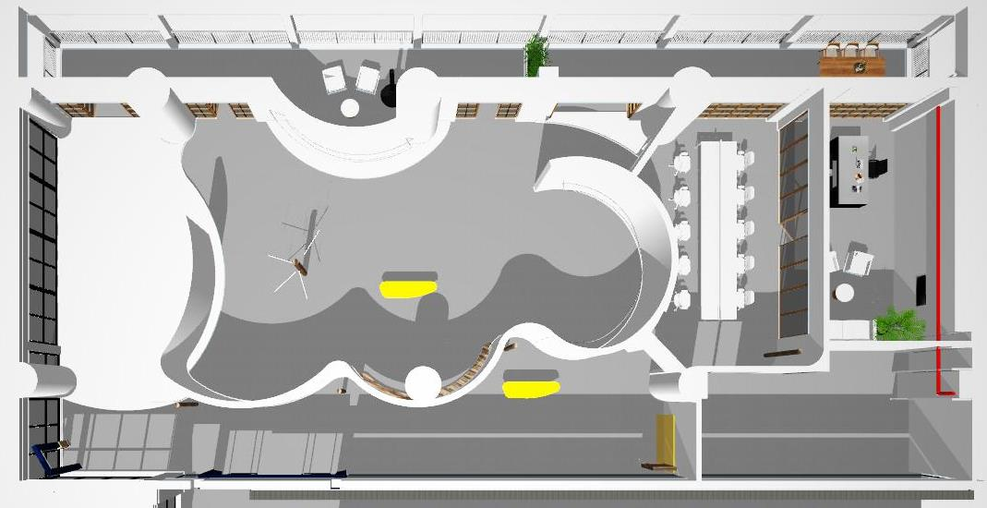
CONCEPT |透视模型PROPOSED LAYOUT
INVSON应尚
浙江

Slide 4
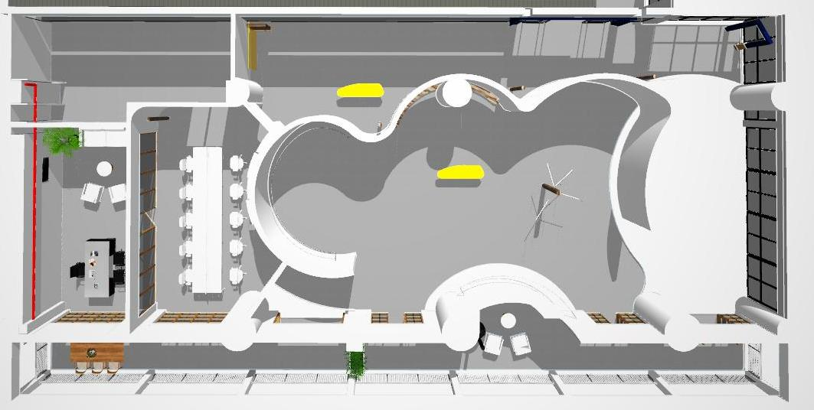
CONCEPT |透视模型PROPOSED LAYOUT
INVSON应尚
浙江

Slide 5
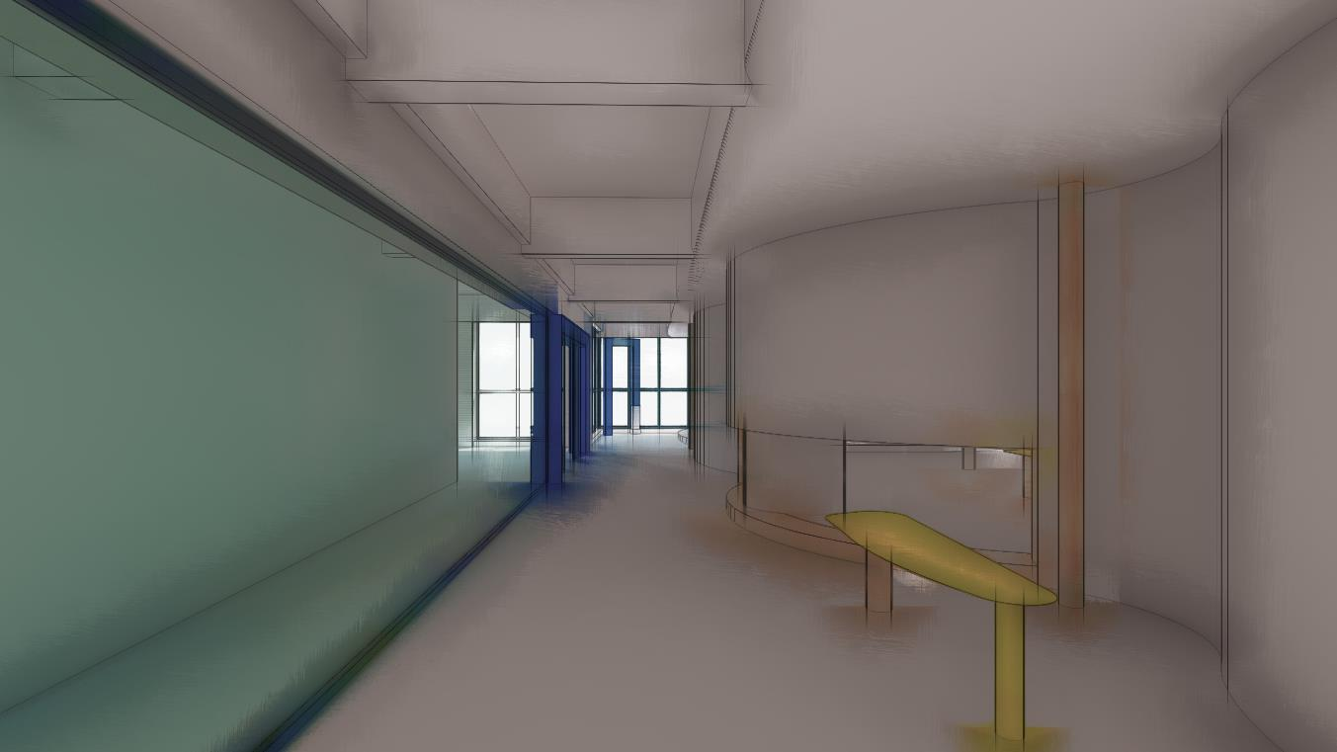
CONCEPT |透视模型PROPOSED LAYOUT
INVSON应尚
浙江

Slide 6
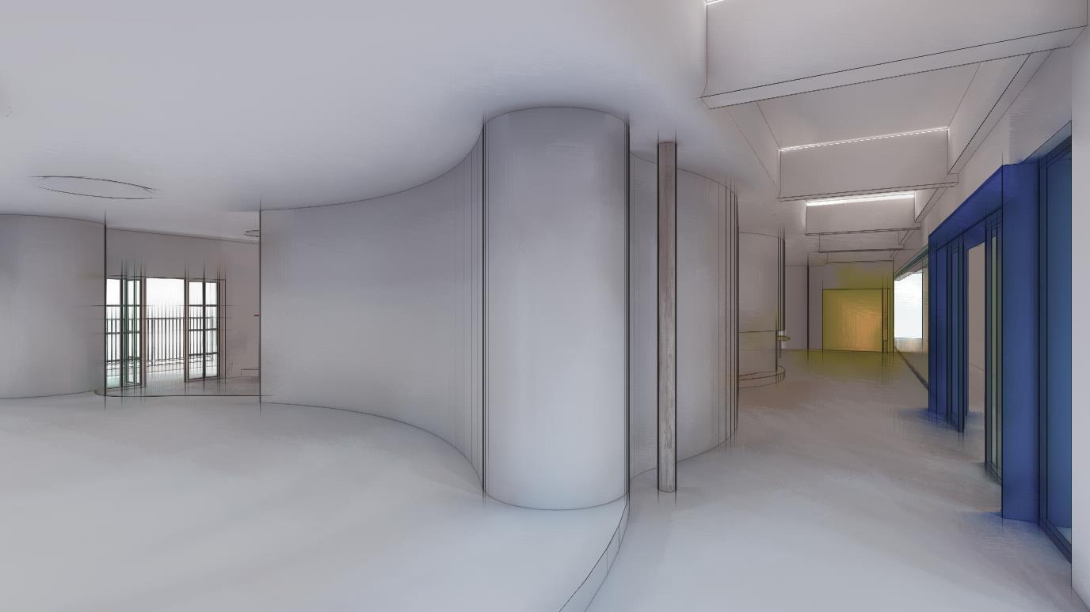
CONCEPT |透视模型PROPOSED LAYOUT
INVSON应尚
浙江

Slide 7
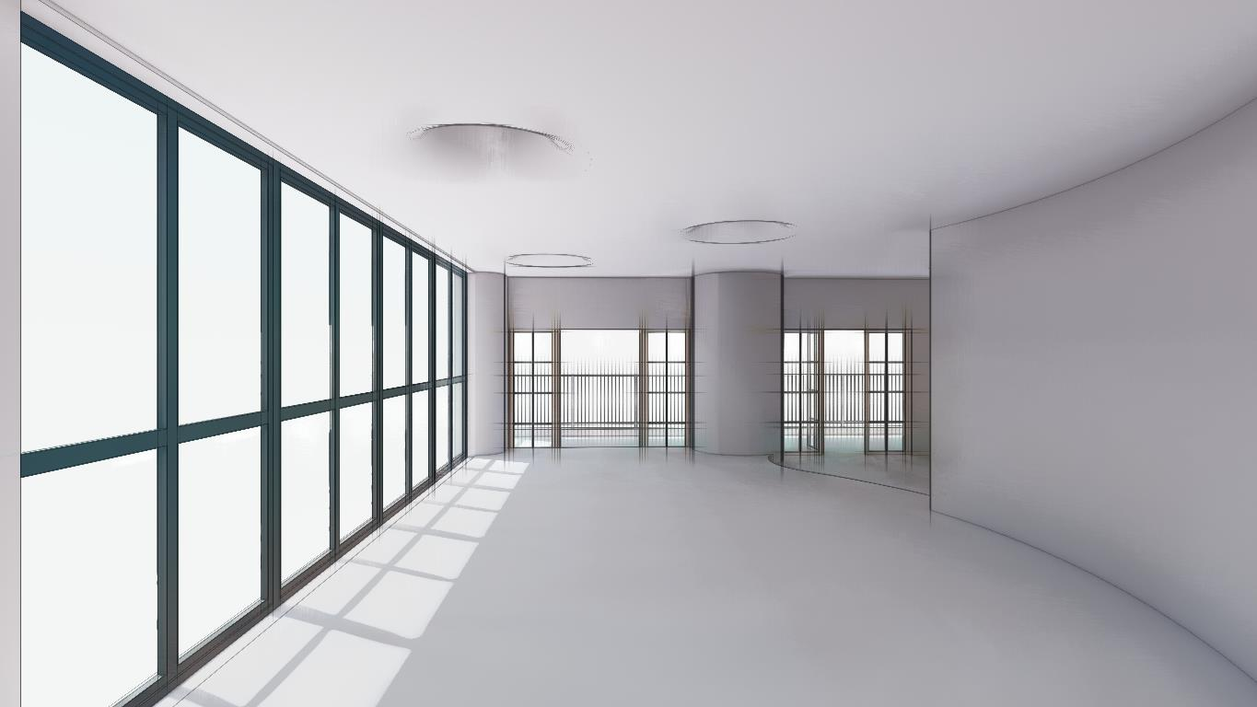
CONCEPT |透视模型PROPOSED LAYOUT
INVSON应尚
浙江

Slide 8
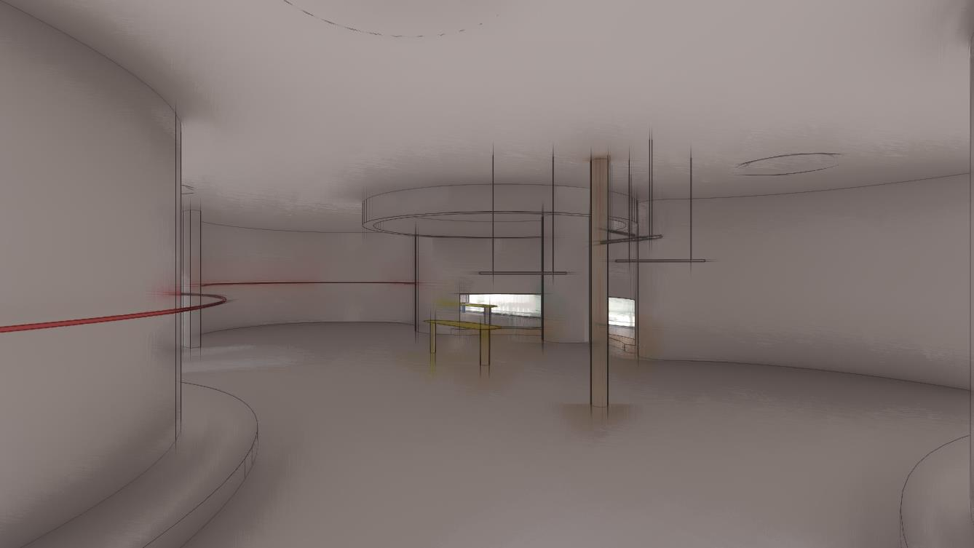
CONCEPT |透视模型PROPOSED LAYOUT
INVSON应尚
浙江

Slide 9
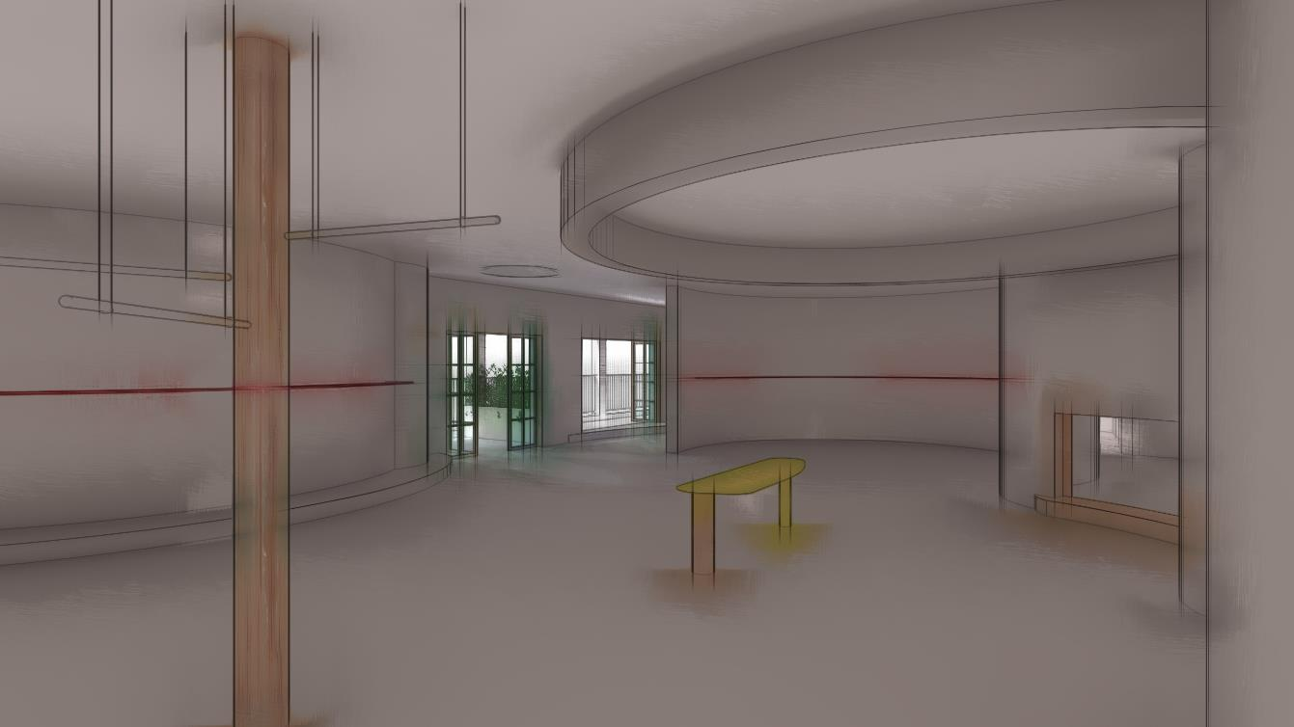
CONCEPT |透视模型PROPOSED LAYOUT
INVSON应尚
浙江

Slide 10
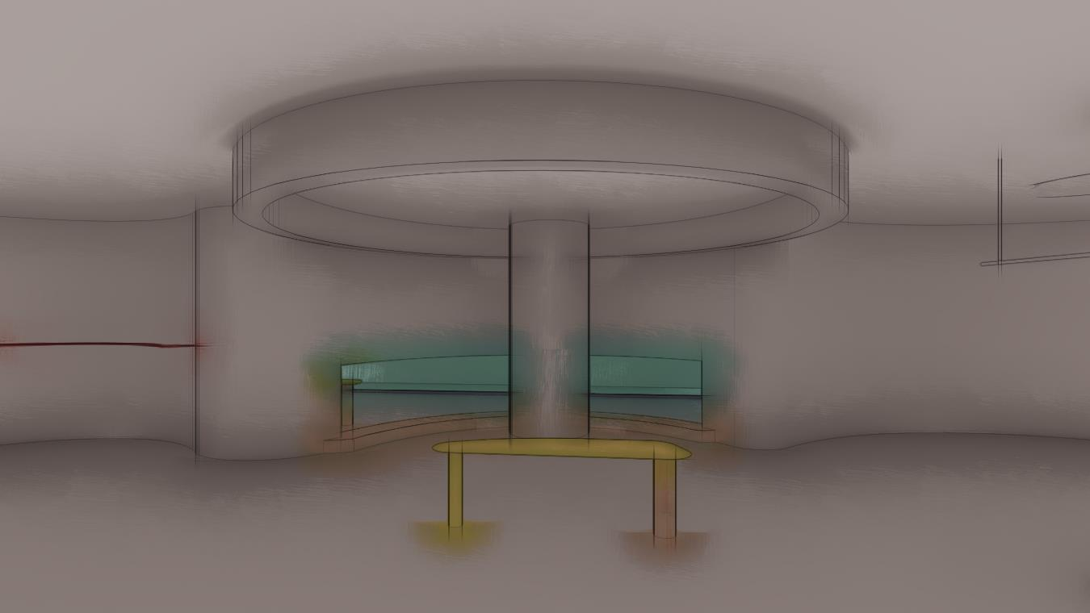
CONCEPT |透视模型PROPOSED LAYOUT
INVSON应尚
浙江

Slide 11
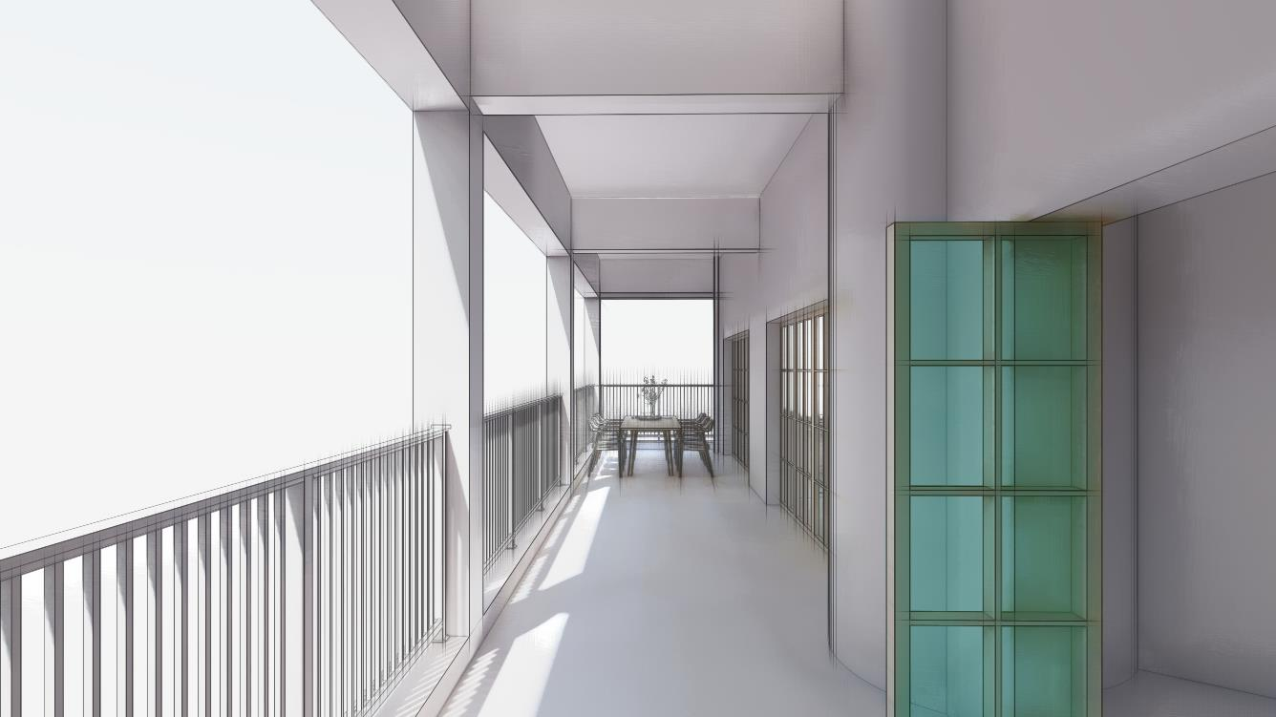
CONCEPT |透视模型PROPOSED LAYOUT
INVSON应尚
浙江

Slide 12
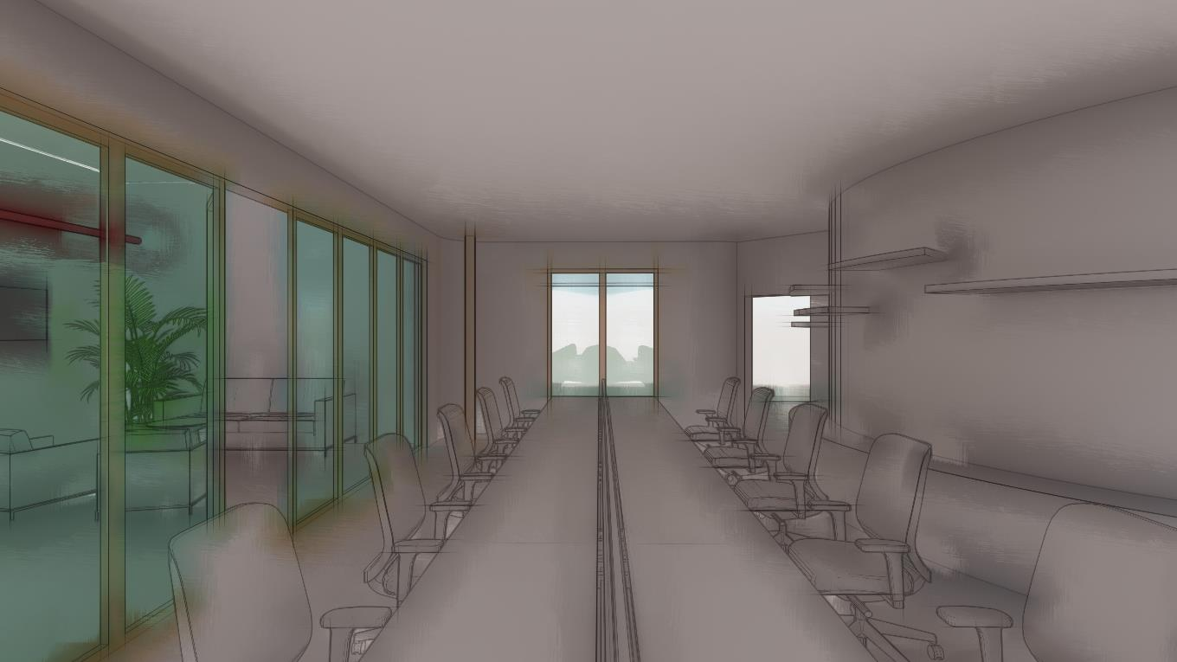
CONCEPT |透视模型PROPOSED LAYOUT
INVSON应尚
浙江

Slide 13
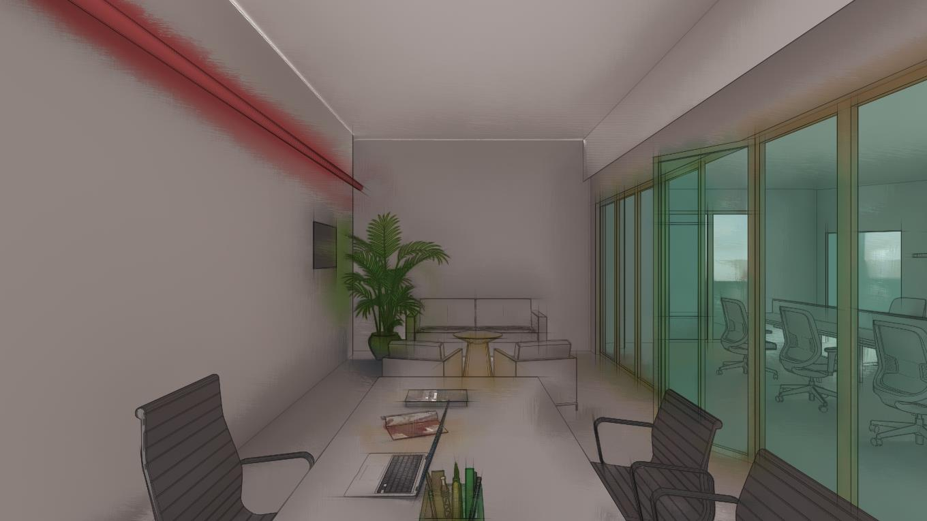
CONCEPT |透视模型PROPOSED LAYOUT
INVSON应尚
浙江

Slide 14
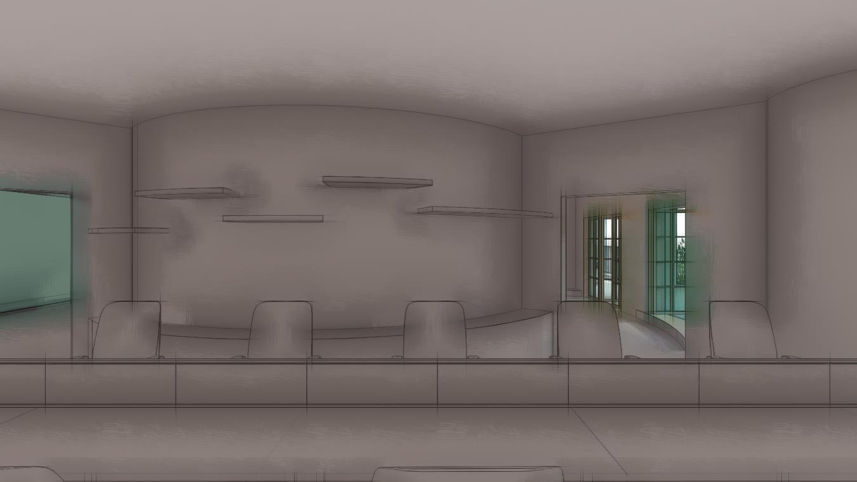
CONCEPT |透视模型PROPOSED LAYOUT
INVSON应尚
浙江

Slide 15
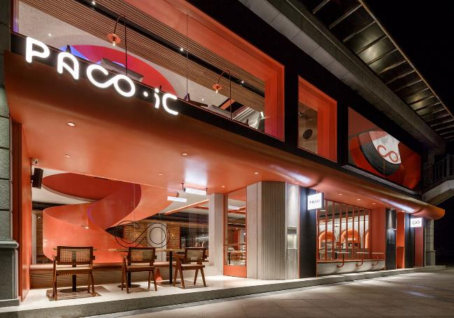
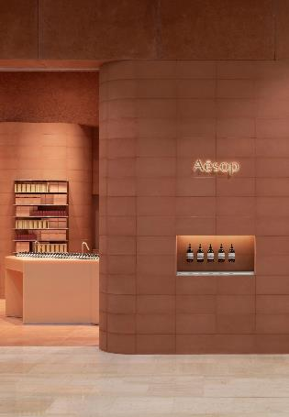
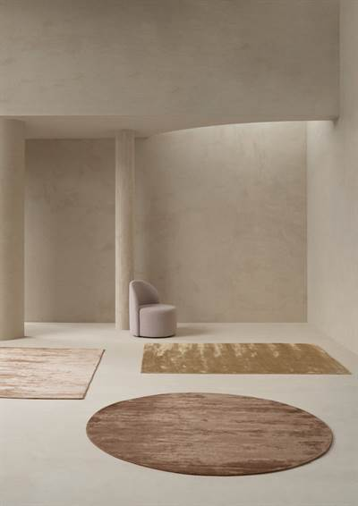
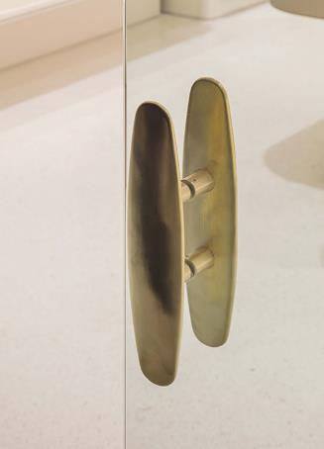
CONCEPT |参考图PROPOSED LAYOUT
INVSON应尚
浙江

Slide 16
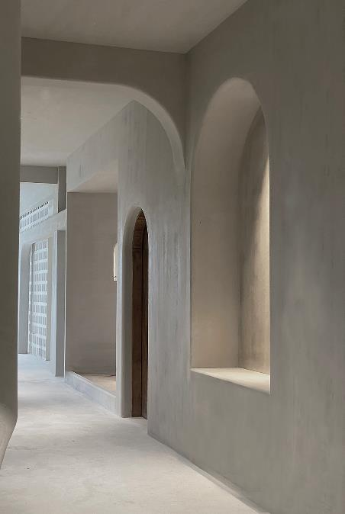
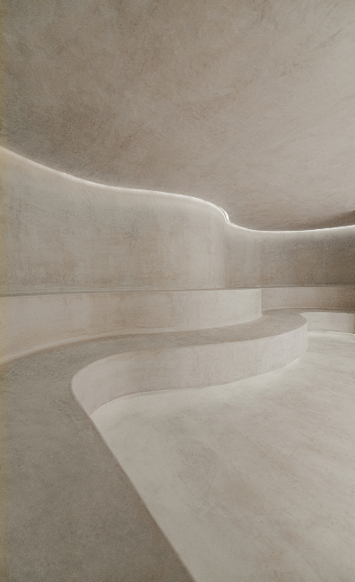
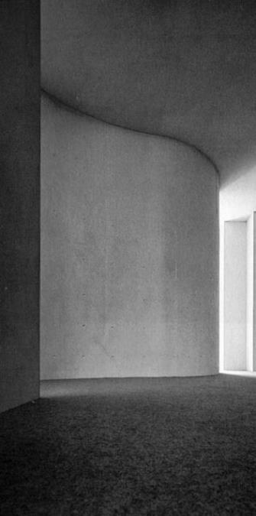

CONCEPT |参考图PROPOSED LAYOUT
INVSON应尚
浙江

Slide 17
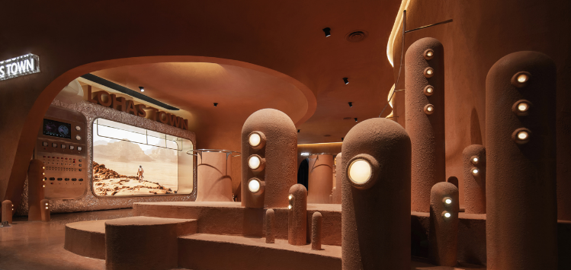
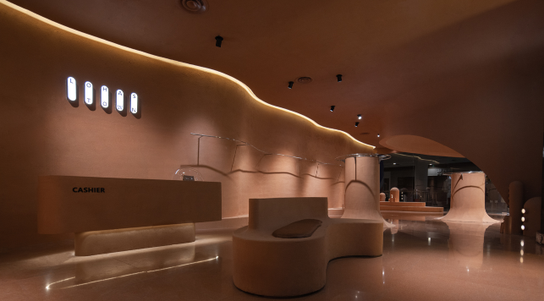
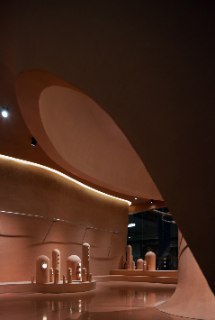

CONCEPT |参考图PROPOSED LAYOUT
INVSON应尚
浙江

Slide 18
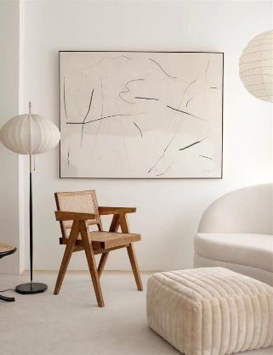
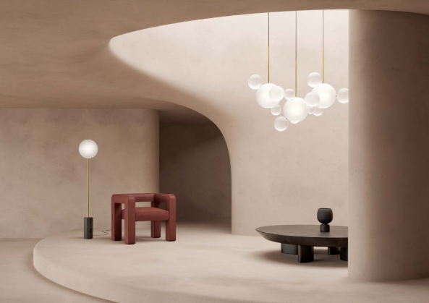
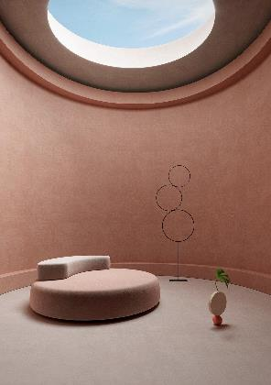
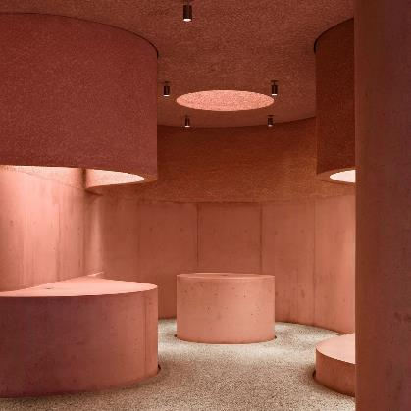
CONCEPT |参考图PROPOSED LAYOUT
INVSON应尚
浙江

Slide 19
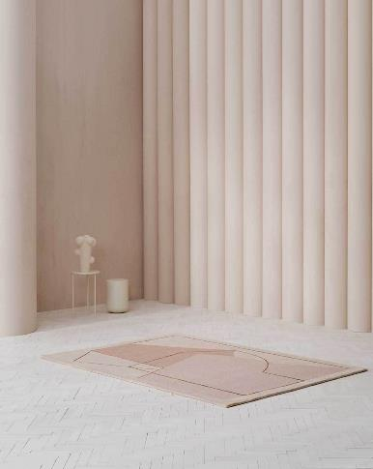
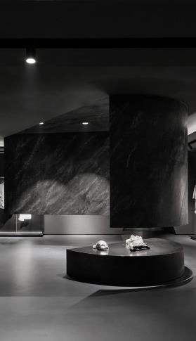
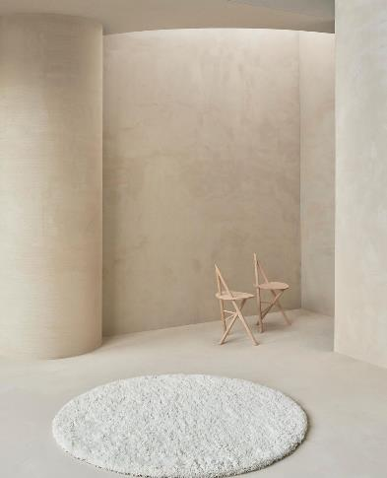
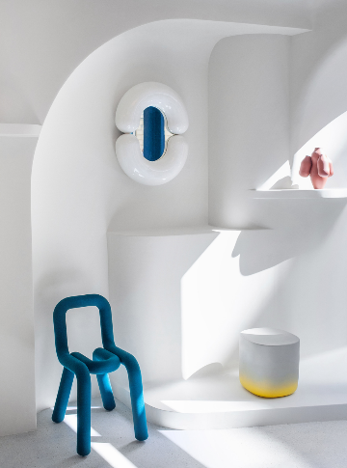
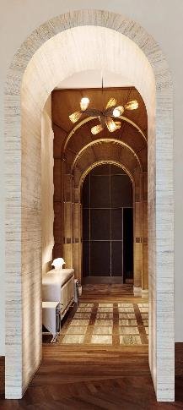
CONCEPT |参考图PROPOSED LAYOUT
INVSON应尚
浙江

Slide 20
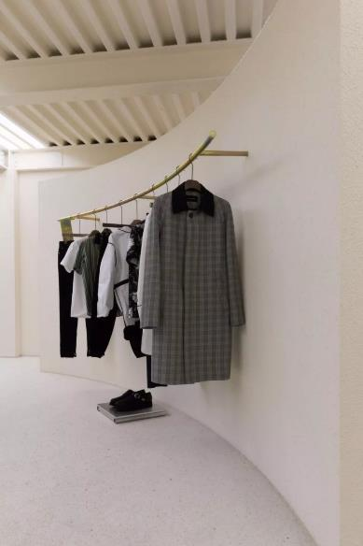
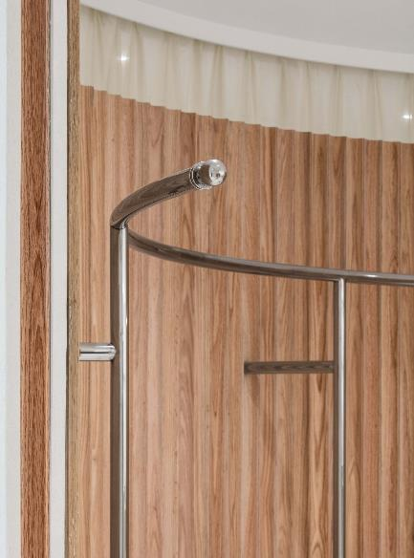
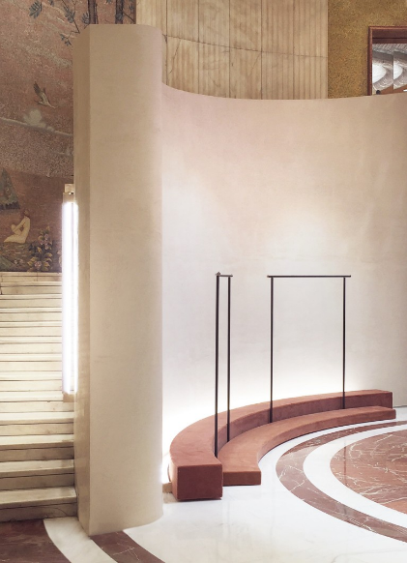
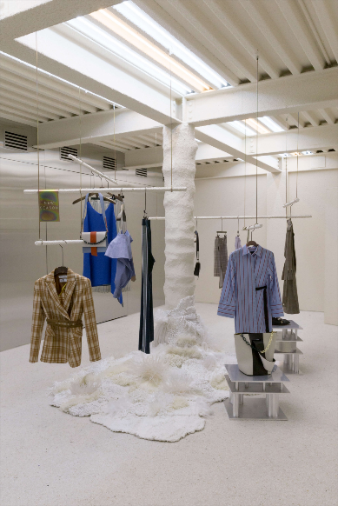
CONCEPT |参考图PROPOSED LAYOUT
INVSON应尚
浙江

Slide 21
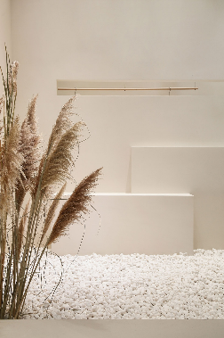
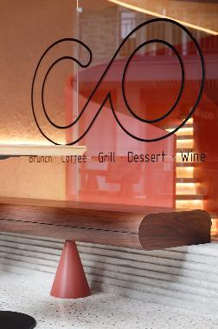
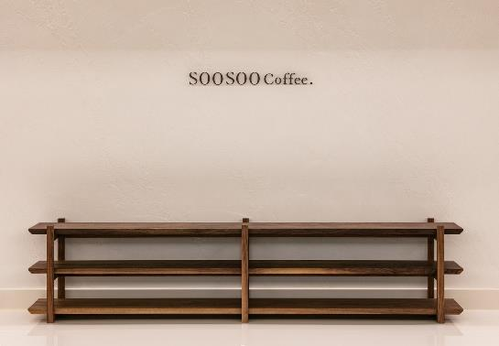
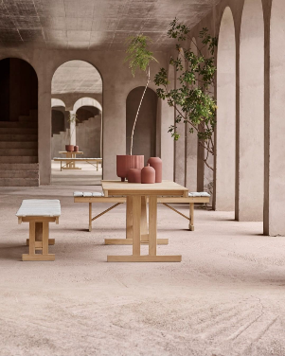
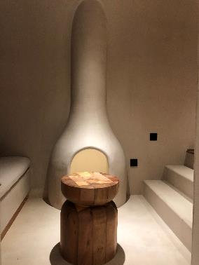
CONCEPT |参考图PROPOSED LAYOUT
INVSON应尚
浙江

Slide 22
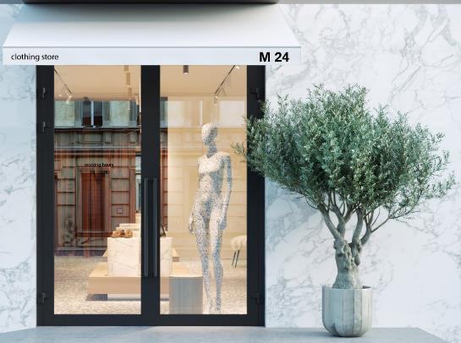
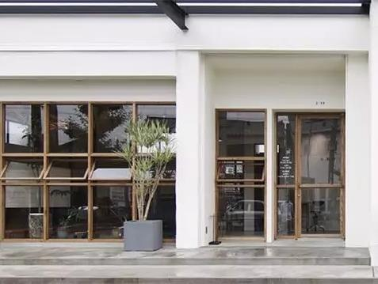
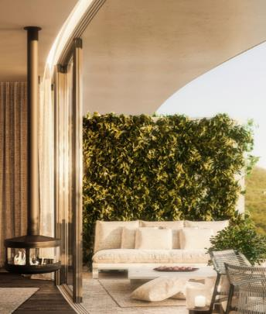
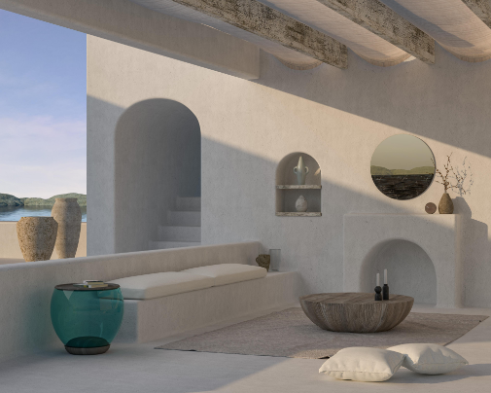
CONCEPT |参考图PROPOSED LAYOUT
INVSON应尚
浙江

Slide 23
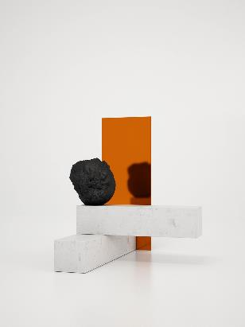
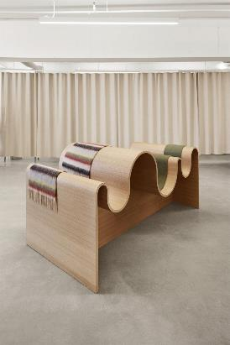
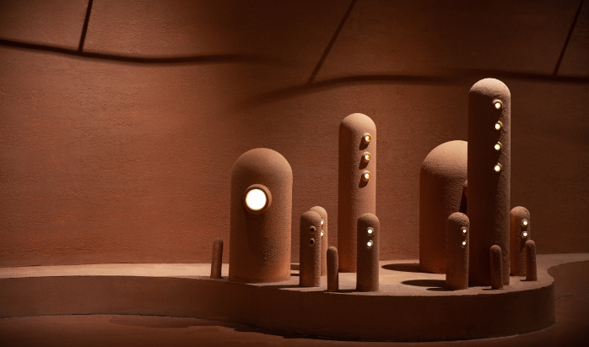
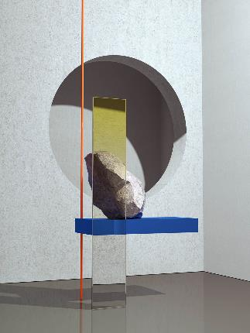


CONCEPT |参考图PROPOSED LAYOUT
INVSON应尚
浙江

Slide 24








CONCEPT |参考图PROPOSED LAYOUT
INVSON应尚
浙江
INVSON应尚
浙江

Slide 25


THANKS

