Slide 1
第一章
夯实基础过教材——分册复习
第四节 八年级（下）

Slide 2
Have you ever been to a museum ?
Units 9

Slide 3
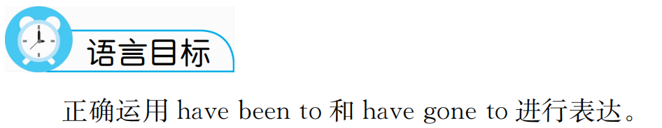

Slide 4
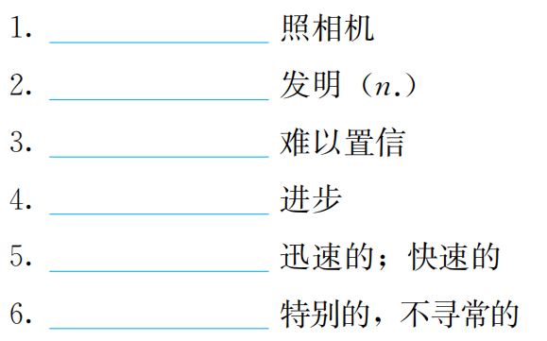
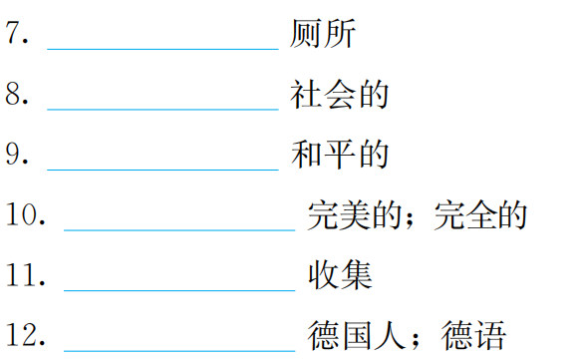
重点单词
camera
toilet
invention
social
unbelievable
peaceful
progress
perfect
rapid
collect
unusual
German

Slide 5
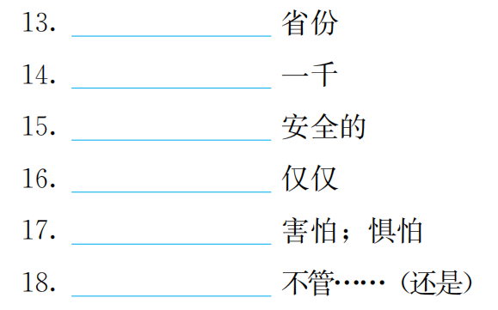
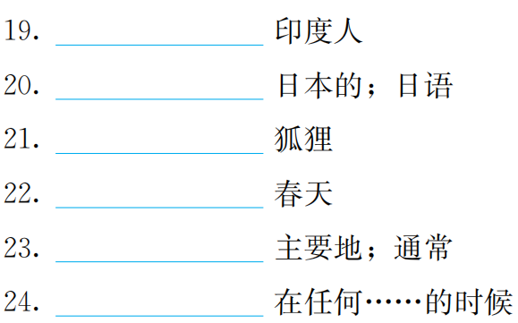
province
Indian
thousand
Japanese
safe
fox
simply
spring
fear
mostly
whether
whenever

Slide 6
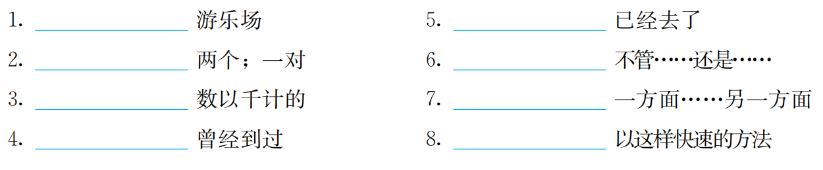
重点短语
amusement park
have has gone to
a couple of
whether…or
on the one hand…
on the other hand…
thousands of
have has been to
in such a rapid way

Slide 7
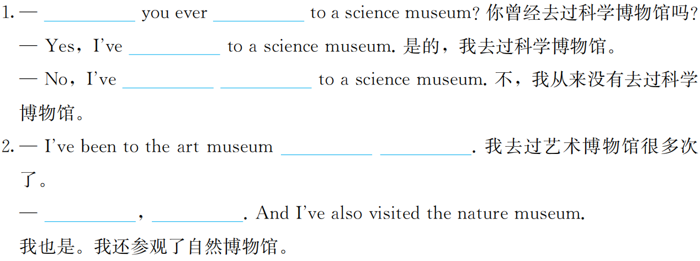
重点句型回顾及情景交际
Have
been
been
never
been
many
times
Me
too

Slide 8
语法精要
话题

Slide 9
巩固练习

Slide 10
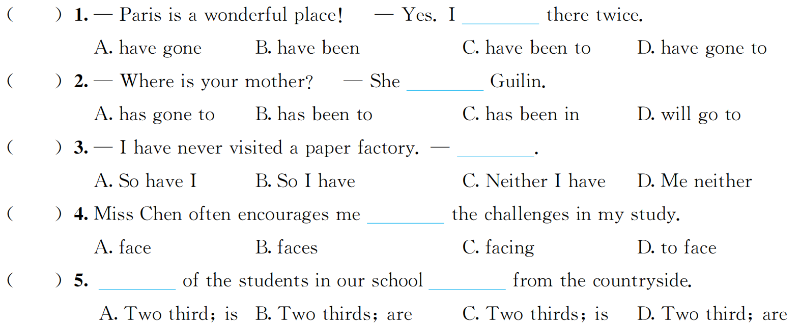
一、单项选择
B
A
D
D
B

Slide 11
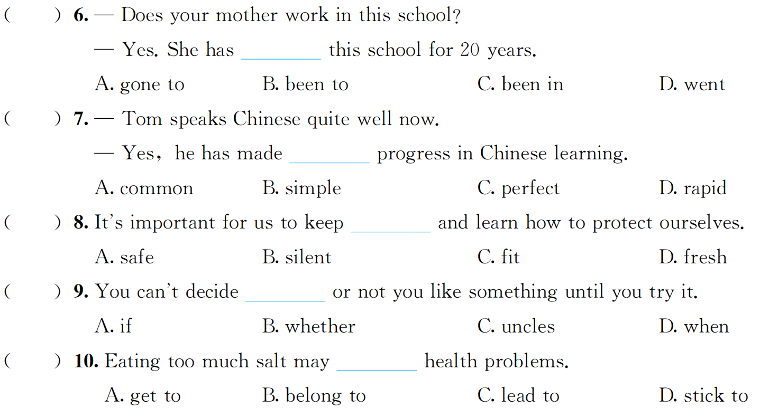
C
D
A
B
C

Slide 12
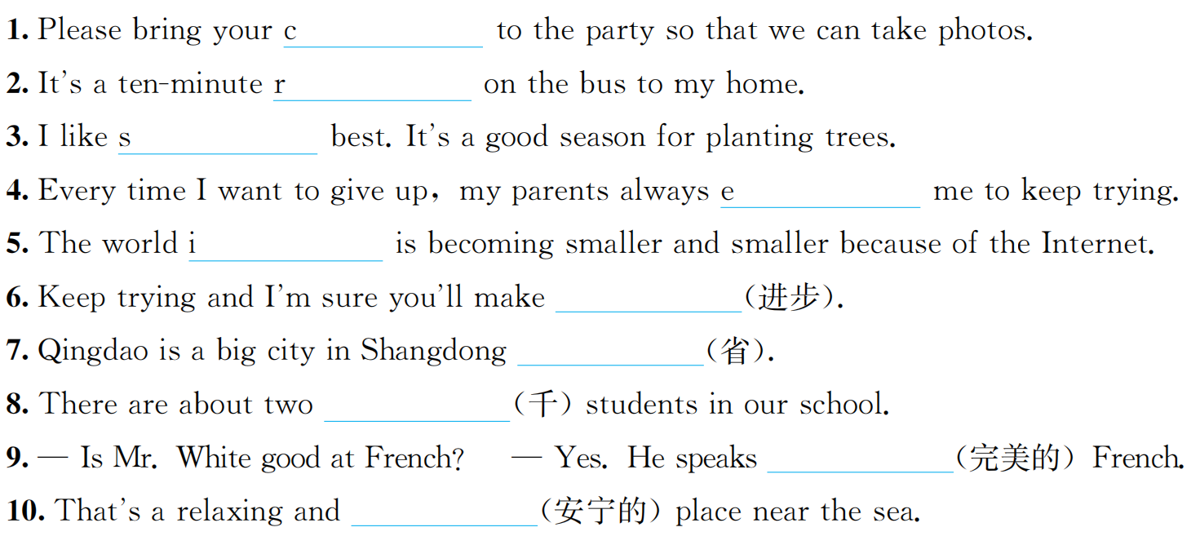
二、单词拼写
amera
ide
pring
ncourage
tself
progress
Province
thousand
perfect
peaceful

Slide 13
I’ve had this bike for three years .
Units 10

Slide 14
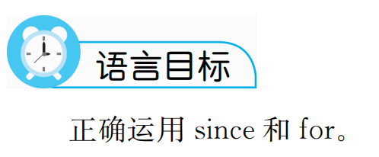

Slide 15
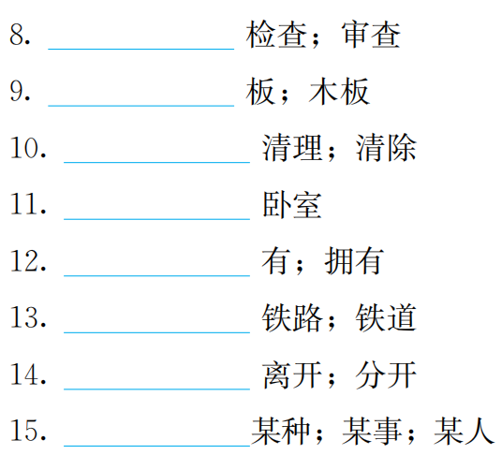
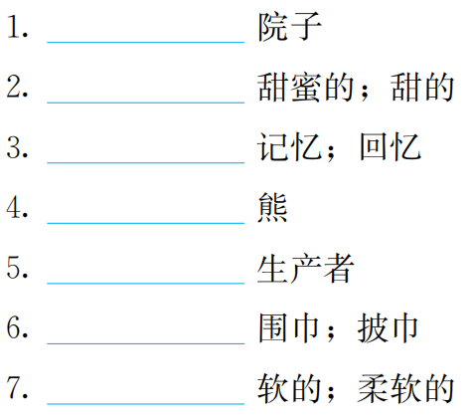
重点单词
check
yard
board
sweet
clear
memory
bedroom
bear
own
maker
railway
scarf
part
soft
certain

Slide 16
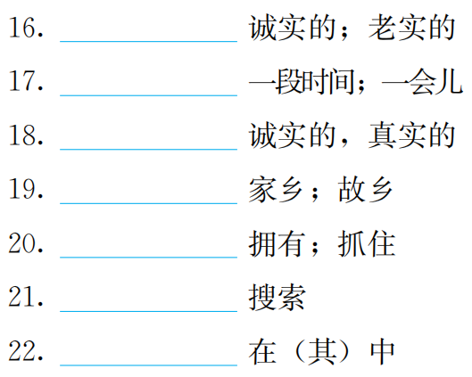
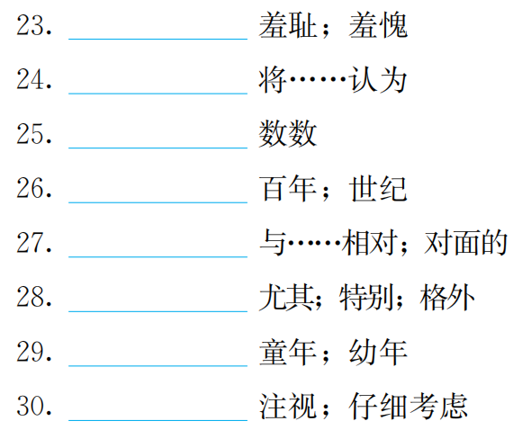
honest
shame
while
regard
truthful
count
hometown
century
hold
opposite
especially
search
childhood
among
consider

Slide 17
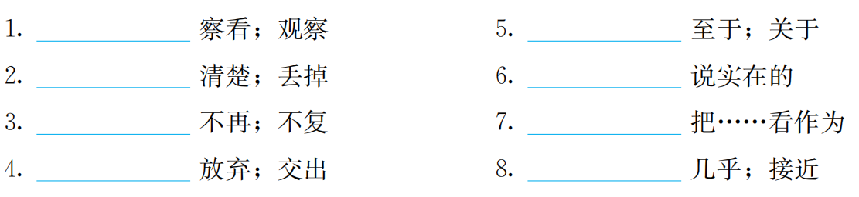
重点短语
check out
as for
clear out
to be honest
no longer
regard…as…
part with
close to

Slide 18
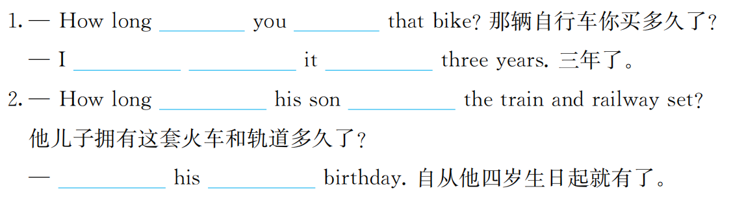
重点句型回顾及情景交际
Have
had
have
had
for
Has
owned
Since
fourth

Slide 19
语法精要
话题

Slide 20
巩固练习

Slide 21
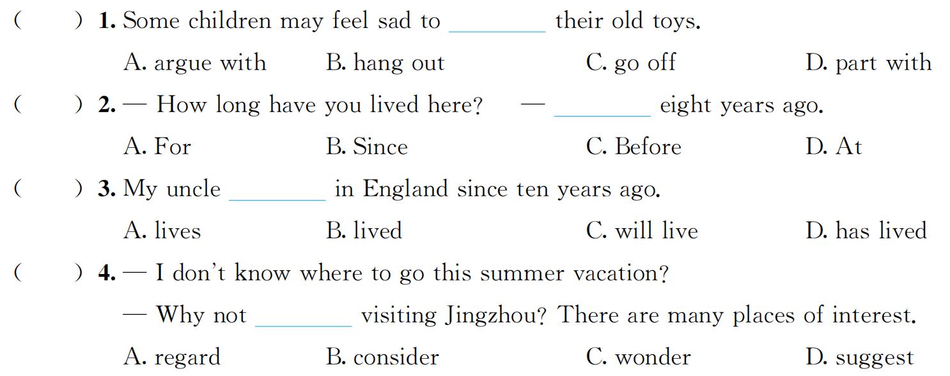
一、单项选择
D
B
D
B

Slide 22
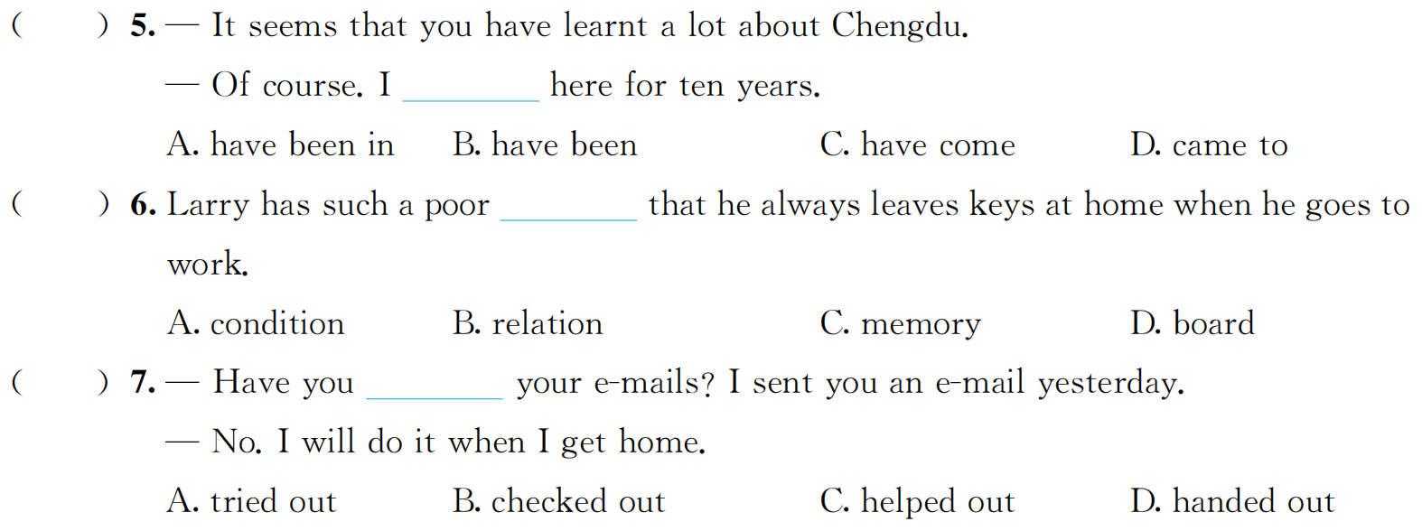
B
C
B

Slide 23
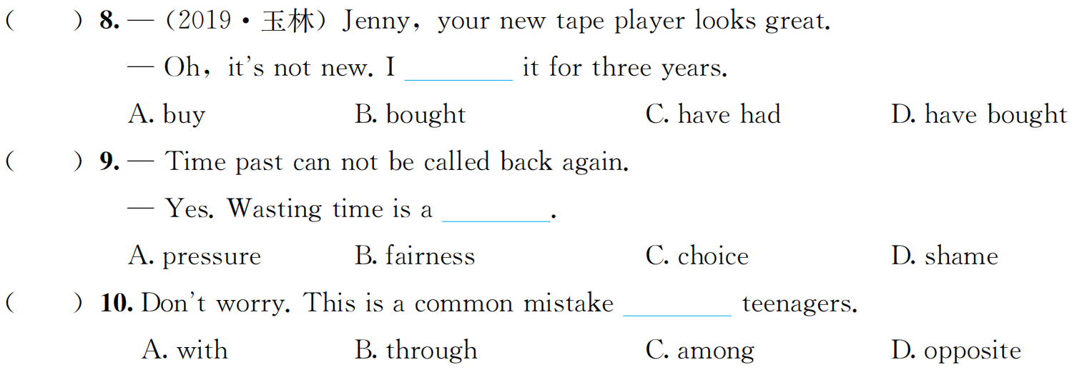
C
D
C

Slide 24
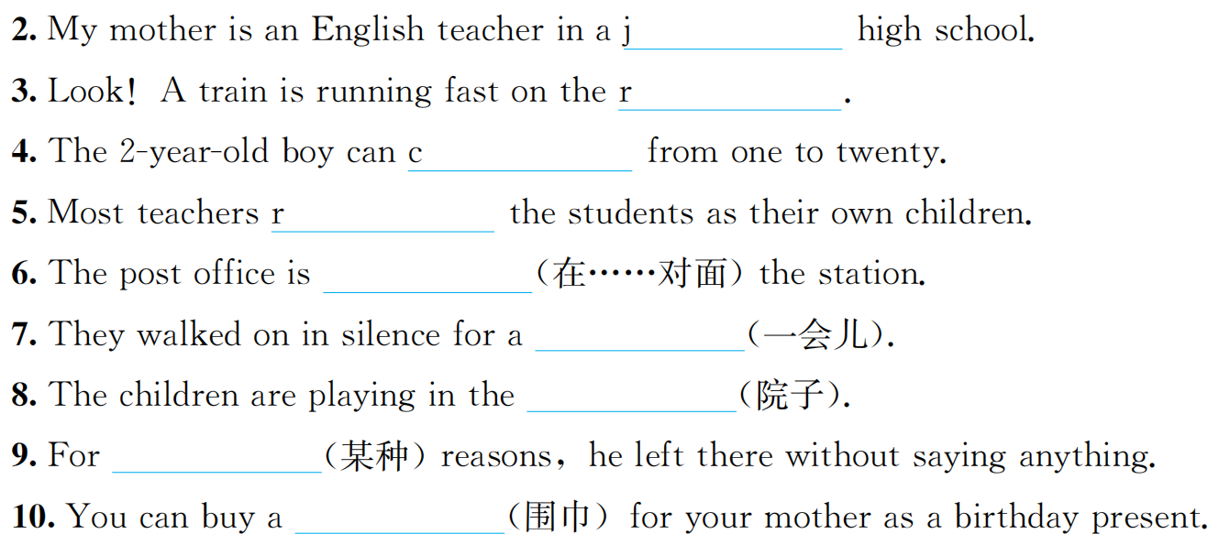
二、单词拼写
weet
unior
ailway
ount
egard
opposite
while
yard
certain
scarf

