Slide 1

免疫治疗背景下：
细胞因子的选择及相关应用
Sino Biological Inc.

Slide 2

CONTENT
1
免疫治疗中CAR-T细胞治疗进展概述
CAR-T细胞治疗和抗体药研发中细胞因子的应用及相关产品的介绍
2
Sino Biological Inc.

Slide 3
01
免疫治疗中CAR-T细胞治疗进展概述

Slide 4

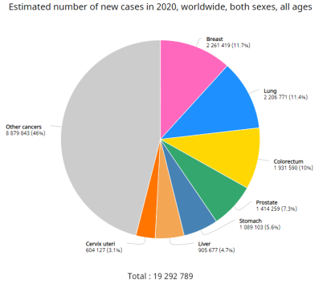
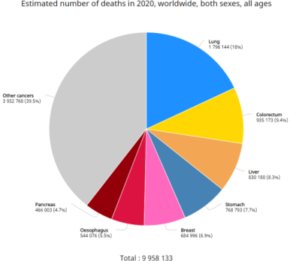

Global Cancer Statistics 2020
放疗
免疫治疗
化疗
癌症治疗
种类
靶向治疗
手术
干细胞移植
激素治疗
什么是免疫治疗？
癌症仍然是全球性的健康问题。GLOBOCAN 2020数据库显示，2020年全球新发癌症大约在1千9百多万例，近千万例癌症患者死亡(Figure 1) ^{[1]}。
目前治疗癌症的方法有许多，免疫治疗就是其中之一。免疫治疗主要是用免疫系统去对抗癌症。
[1]Hyuna Sung et al., “Global Cancer Statistics 2020: GLOBOCAN Estimates of Incidence and Mortality Worldwide for 36 Cancers in 185 Countries,” CA: A Cancer Journal for Clinicians n/a, no. n/a, accessed February 7, 2021, https://doi.org/10.3322/caac.21660.
Sino Biological Inc.

Slide 5
免疫治疗的主要种类
癌症疫苗
免疫检查点抑制剂
单抗药
细胞因子
CAR-T 细胞治疗
…
靶点 | FDA-approved therapeutic
CD20 | Rituximab (RITUXAN®)
VEGF | Bevacizumab (Avastin®)
HER2 | Trastuzumab (Herceptin® )
靶点 | FDA-approved therapeutic
PD-1 | nivolumab (Opdivo®) pembrolizumab (Keytruda®)
PD-L1 | atezolizumab (Tecentriq®) durvalumab (Imfinzi®) avelumab(Bavencio®)
CTLA-4 | Ipilimumab(YERVOY®)
义翘神州

Slide 6
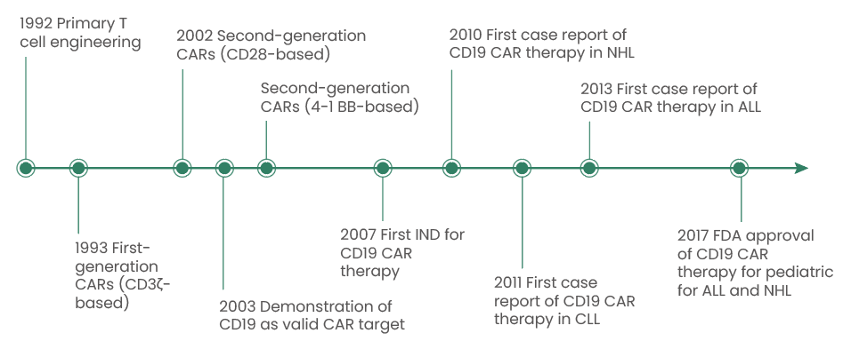
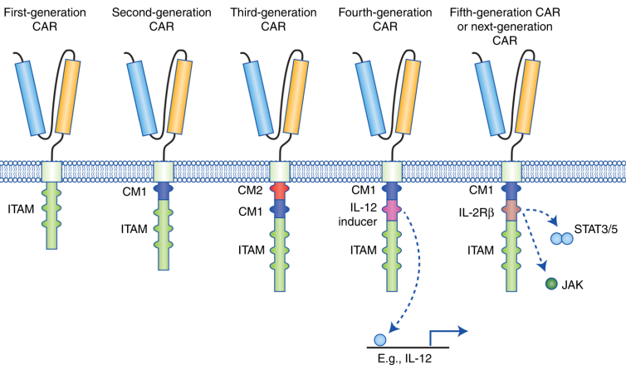
CAR-T 细胞治疗
CAR 细胞治疗的简要发展时间线^{[1]}
FDA批准的CAR-T 细胞治疗^{[3]}
靶点 | FDA-approved therapeutic | Indication | First approved data
CD19 | tisagenlecleucel (Kymriah™ ) | 3-25岁患者复发性或难治性B 细胞前体急性淋巴细胞白血病； 成年患者复发或难治性 大 B 细胞淋巴瘤 | 2017.8
 | axicabtagene ciloleucel (Yescarta™) | 成年患者复发性或难治性大B细胞淋巴瘤 | 2017.10
 | brexucabtagene autoleucel(Tecartus™) | 成年患者复发性或难治性套细胞淋巴瘤 ； 成人复发性或难治性 B 细胞前体急性淋巴细胞白血病 | 2020.7
 | lisocabtagene maraleucel(Breyanzi®) | 成年患者复发或难治性大 B 细胞淋巴瘤 | 2021.2
BCMA | idecabtagene vicleucel (Abecma®) | 成年患者复发或难治性多发性骨髓瘤 | 2021.3
 | ciltacabtagene autoleucel (CARVYKTITM) | 成年患者复发或难治性多发性骨髓瘤 | 2022.2
1-5代CAR 的结构^{[2]}
[1] “Bridging T Cells to Tumors: CARs vs BsAb,” Immuno-Oncology Research Trends, accessed May 30, 2022, https://natasaobermajer.com/home/2018/7/21/cancer-re-direction-and-t-cell-therapies-cars-vs-bites-or-tcr-and-immtacs.
[2] Nicholas Tokarew et al., “Teaching an Old Dog New Tricks: Next-Generation CAR T Cells,” British Journal of Cancer 120, no. 1 (January 2019): 26–37, https://doi.org/10.1038/s41416-018-0325-1.
[3]Vita Golubovskaya and Lijun Wu, “Different Subsets of T Cells, Memory, Effector Functions, and CAR-T Immunotherapy,” Cancers 8, no. 3 (March 15, 2016): 36, https://doi.org/10.3390/cancers8030036.
义翘神州

Slide 7
02
CAR-T细胞治疗和抗体药研发中细胞因子的应用及相关产品的介绍
义翘神州

Slide 8
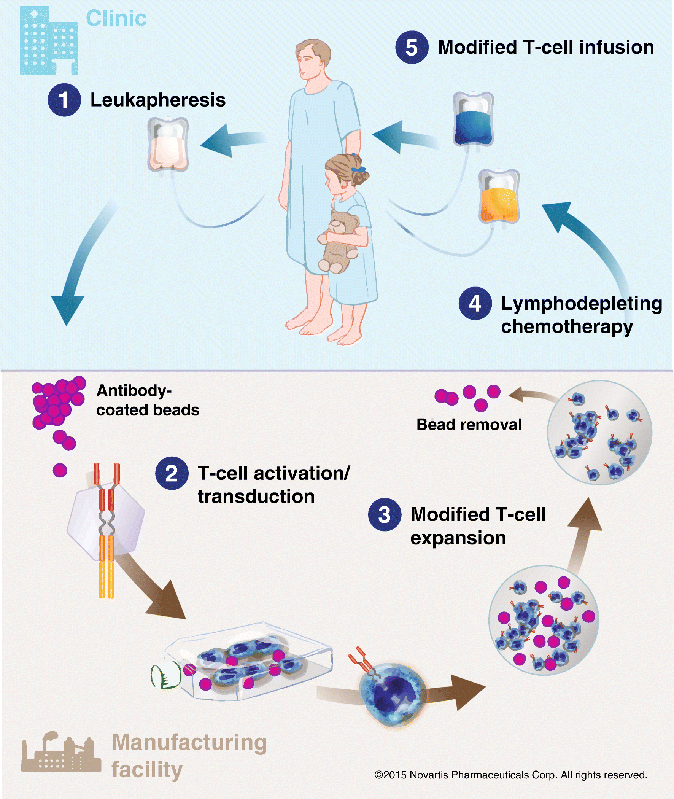
CAR-T 细胞治疗
Tisagenlecleucel 治疗的主要步骤^{[1]}
采集患者血样
T细胞分离
T细胞活化
转染CAR组件
T细胞增殖和配制
质控和放行
患者回输
(anti CD3 antibody, anti CD28 antibody)
[1] Stacie Ittershagen et al., “Industry’s Giant Leap Into Cellular Therapy: Catalyzing Chimeric Antigen Receptor T Cell (CAR-T) Immunotherapy,” Current Hematologic Malignancy Reports 14, no. 1 (February 1, 2019): 47–55, https://doi.org/10.1007/s11899-019-0498-6.
义翘神州

Slide 9
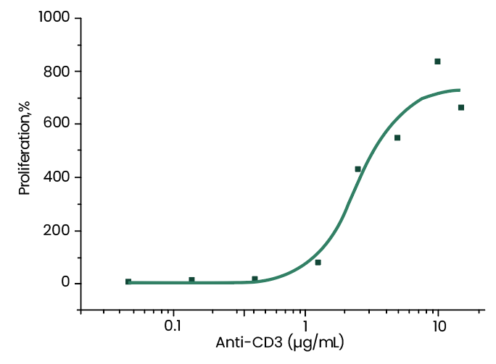
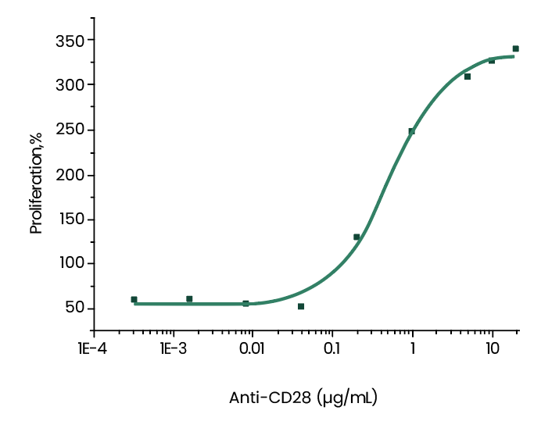
CAR-T 细胞治疗
T cell活化
anti CD3 antibody
anti CD28 antibody
Effect of Human CD3 antibody on the proliferation and IFN-gamma secretion of CD4+ T cell.
Effect of human CD28 antibody on stimulating IL-2 secretion of CD4 T cells co-activated with CD3 antibody.
义翘神州

Slide 10
CAR-T 细胞治疗
Tisagenlecleucel 治疗的主要步骤[1]
采集患者血样
T细胞分离
T细胞活化
转染CAR组件
T细胞增殖和配制
质控和放行
患者回输
(anti CD3 antibody, anti CD28 antibody)
(Cytokines:IL2, IL21, IL7, IL15)
[1] Stacie Ittershagen et al., “Industry’s Giant Leap Into Cellular Therapy: Catalyzing Chimeric Antigen Receptor T Cell (CAR-T) Immunotherapy,” Current Hematologic Malignancy Reports 14, no. 1 (February 1, 2019): 47–55, https://doi.org/10.1007/s11899-019-0498-6.
义翘神州

Slide 11
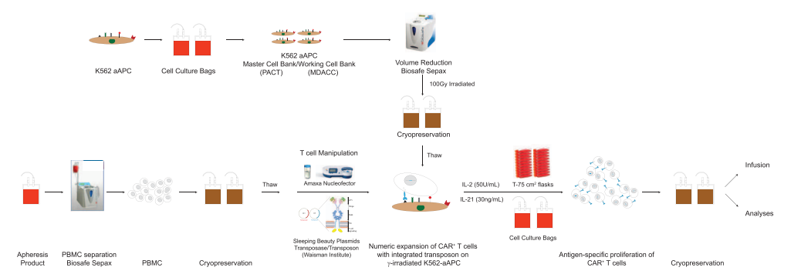
CAR-T 细胞制备
Generation and transduction of activated T cells^{[1]}
收集到的PBMCs用 OKT3 antibody 和rhIL-2 (100 U/ml)激活
转染
转染后的T cell lines的 培养基中一周加入2次 rhIL-2 (50–100 U/ml)
T cell activation, transduction, and expansion conditions^{[3]}
PMBC激活
转染
增殖：
加入IL-2 (360 IU/ml )
加入IL7+IL15 at 10+10 ng/ml
加入IL15+IL21 at 10+10 ng/ml
Manufacture of CAR+ T cells^{[2]}
按周期在过程中加入IL-21(30ng/mL) 和50U/mL IL-2
Cell lines and CAR-T cell generation^{[4]}
PMBC激活
转染
增殖：加入IL7+IL15 at 10+5 ng/ml
[1] Barbara Savoldo et al., “CD28 Costimulation Improves Expansion and Persistence of Chimeric Antigen Receptor–Modified T Cells in Lymphoma Patients,” The Journal of Clinical Investigation 121, no. 5 (May 2, 2011): 1822–26, https://doi.org/10.1172/JCI46110.
[2] Harjeet Singh et al., “Manufacture of Clinical-Grade CD19-Specific T Cells Stably Expressing Chimeric Antigen Receptor Using Sleeping Beauty System and Artificial Antigen Presenting Cells,” PLoS ONE 8, no. 5 (May 31, 2013): e64138, https://doi.org/10.1371/journal.pone.0064138.
[3]Cor H.J. Lamers et al., “T Cell Receptor-Engineered T Cells to Treat Solid Tumors: T Cell Processing Toward Optimal T Cell Fitness,” Human Gene Therapy Methods 25, no. 6 (December 1, 2014): 345–57, https://doi.org/10.1089/hgtb.2014.051.
[4]Yang Xu et al., “Closely Related T-Memory Stem Cells Correlate with in Vivo Expansion of CAR.CD19-T Cells and Are Preserved by IL-7 and IL-15,” Blood 123, no. 24 (June 12, 2014): 3750–59, https://doi.org/10.1182/blood-2014-01-552174.
义翘神州

Slide 12
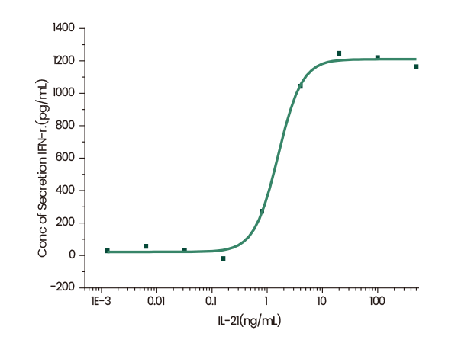
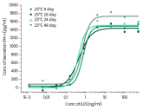
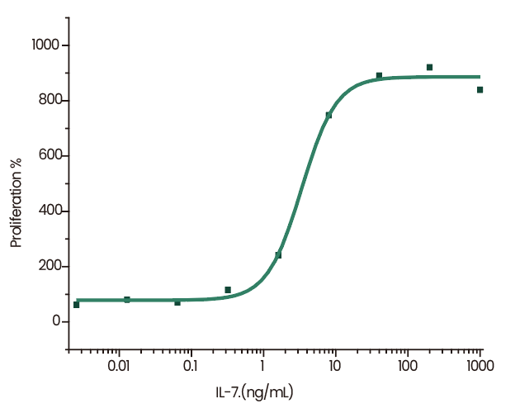
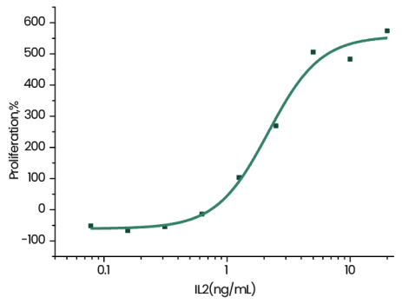
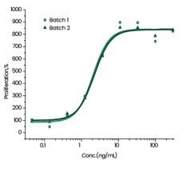
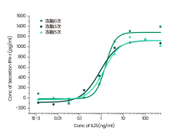
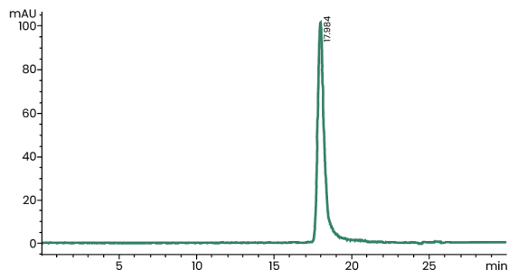
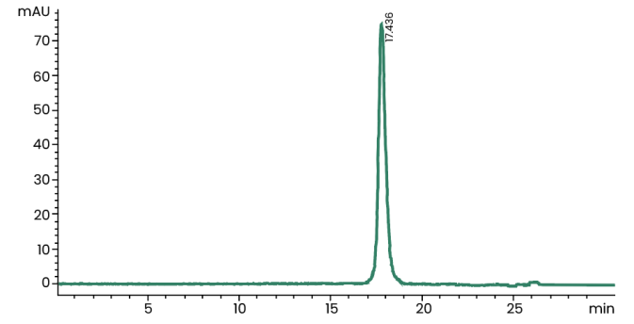
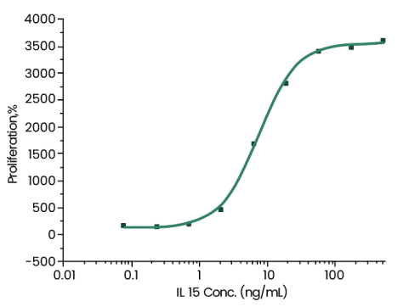
CAR-T 细胞治疗—— T cell增殖
Human IL21
25℃加速48d
Human IL7
Human IL2
批间一致性
冻融5次
Induced Interferon gamma secretion by human natural killer lymphoma NK-92 cells.
Cell proliferation assay using anti-CD3 antibody activated human PBMC. The specific activity is >1x10⁵units/μg, which is calibrated against the human IL-7 reference standard (NIBSC code: 90/530).
Cell proliferation assay using CTLL2. The specific activity of recombinant human IL-2 is approximately 20,000 IU/μg.
Human IL15
≥ 95 % as determined by SEC-HPLC
≥ 95 % as determined by SEC-HPLC
Measured in a cell proliferation assay using MO7e human megakaryocytic leukemic cells.
义翘神州

Slide 13
更高品质细胞因子
质量管理体系 | 质量保证管理 | 质量控制 | 产品特点 | 产品安全性
符合《药品生产质量管理规范》体系 | 供应商管理体系和原材料管理体系 | 符合《中华人民共和国药典》2020年版三部通则：生物制品生产用原材料及辅料质量控制 | 真核&原核表达平台 | 细菌内毒素＜5-10EU/mg
ISO9001:2015和ISO13485：2016质量管理体系 | 文件体系和记录管理完全满足GMP规范要求 | 符合USP<1043>Ancillary Materials For Cell, Gene, and Tissue-engineered Products | 高纯度 | 宿主蛋白残留检测＜0.5μg/mg（500PPm）
FDA DMF备案中 | 完整的批生产记录、批检验记录、分装记录等 |  | 生物活性检测 | 宿主DNA残留检测＜100pg/mg
 | 质量文件/记录经QA审核和批准 |  |  | 支原体检测
 | 建立和运行设备维护和校准程序 |  |  | 无菌检测
 | 专人负责管理人员培训体
义翘神州

Slide 14
免疫治疗的主要种类
癌症疫苗
免疫检查点抑制剂
单抗药
细胞因子
CAR-T 细胞治疗
…
靶点 | FDA-approved therapeutic
CD20 | Rituximab (RITUXAN®)
VEGF | Bevacizumab (Avastin®)
HER2 | Trastuzumab (Herceptin® )
靶点 | FDA-approved therapeutic
PD-1 | nivolumab (Opdivo®) pembrolizumab (Keytruda®)
PD-L1 | atezolizumab (Tecentriq®) durvalumab (Imfinzi®) avelumab(Bavencio®)
CTLA-4 | Ipilimumab(YERVOY®)
义翘神州

Slide 15
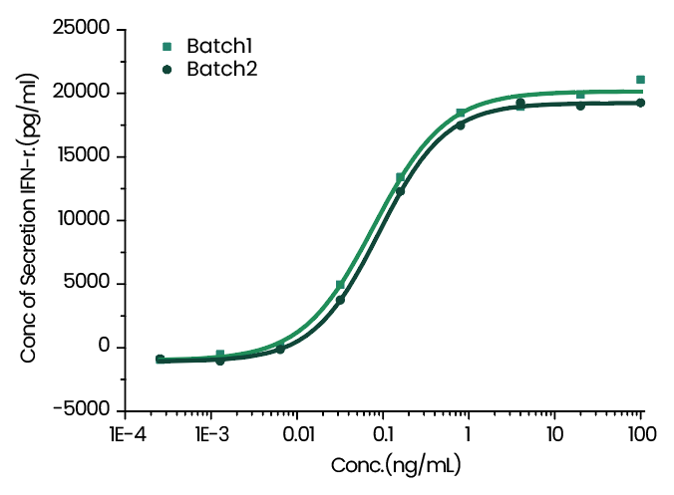
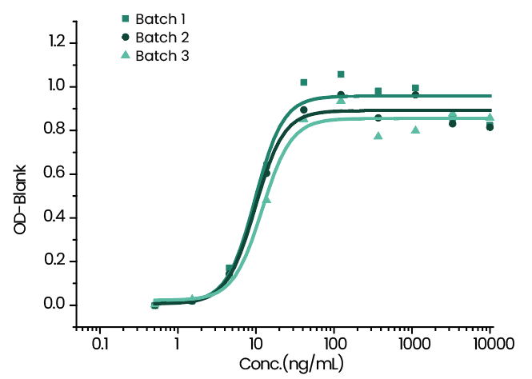
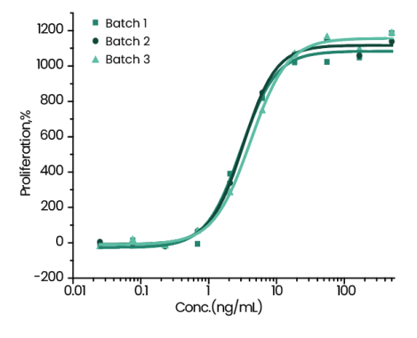
免疫检查点抑制剂
IL12
IL18
免疫检查点抑制剂有可能会在细胞上验证其活性。
比如TIGIT会表达在具有抗肿瘤作用的 T细胞和NK细胞上。TIGIT的表达会抑制NK 细胞对于肿瘤细胞的杀伤。然而当TIGIT被抑制后NK细胞和T细胞会重新恢复功能^{[1]}。
所以当用NK细胞去研究TIGIT抑制剂功能的时候，细胞因子IL12^{[1]}或者细胞因子的组合IL-12, IL-15 and IL-18^{[2]}会被加入其中用来刺激NK细胞。
Induce Interferon gamma secretion by human natural killer lymphoma NK-92 cells.
Induce IFN-gamma secretion by KG‑1 human acute myelogenous leukemia cells in the presence of TNF-alpha.
IL15
Cell proliferation assay using MO7e human megakaryocytic leukemic cells.
[1]Fanqiao Meng et al., “Overexpression of TIGIT in NK and T Cells Contributes to Tumor Immune Escape in Myelodysplastic Syndromes,” Frontiers in Oncology 10 (2020), https://doi.org/10.3389/fonc.2020.01595.
[2]Xiaowan Yin et al., “Expression of the Inhibitory Receptor TIGIT Is Up-Regulated Specifically on NK Cells With CD226 Activating Receptor From HIV-Infected Individuals,” Frontiers in Immunology 9 (2018), https://doi.org/10.3389/fimmu.2018.02341.
义翘神州

Slide 16
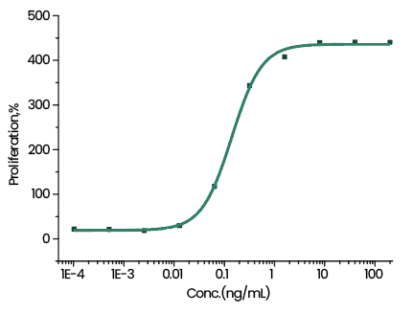
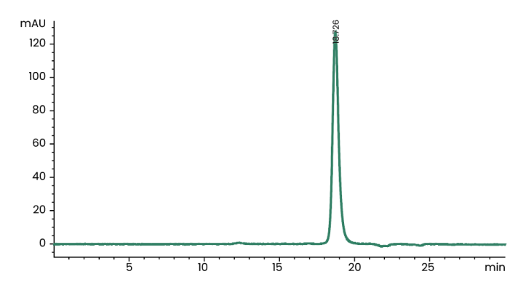
免疫检查点抑制剂
IL4
比如在免疫检查点抑制剂(anti TIGIT mab：BGB-A1217)Fc部分对于该免疫检查点抑制剂抗肿瘤活性中的作用的研究中。作者设计了内吞(trogocytosis)实验，这个实验中 DC 细胞被选用做其中一种acceptor cells. 用来诱导DC 细胞的培养基中加入了100 ng/mL IL-4^{[1]}.
Cell proliferation assay using TF-1 human erythroleukemic cells. The specific activity of recombinant human IL-4 is >10,000 IU/μg which is calibrated against the human IL-4 WHO International Standard (NIBSC code: 88/656).
≥ 95 % as determined by SEC-HPLC
[1] Xin Chen et al., “An Fc-Competent Anti-Human TIGIT Blocking Antibody Ociperlimab (BGB-A1217) Elicits Strong Immune Responses and Potent Anti-Tumor Efficacy in Pre-Clinical Models,” Frontiers in Immunology 13 (2022), https://www.frontiersin.org/article/10.3389/fimmu.2022.828319.
义翘神州

Slide 17
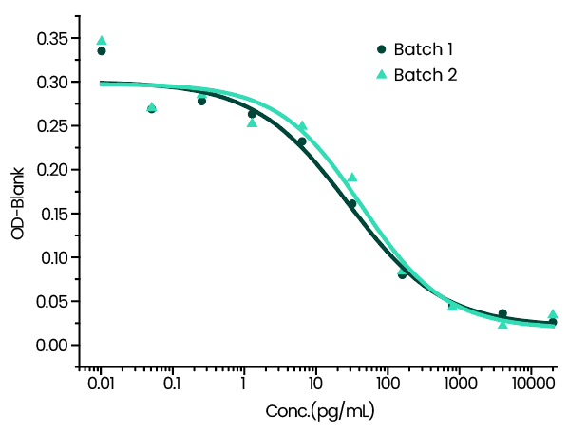
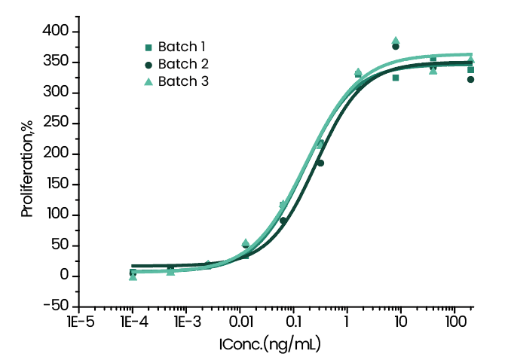
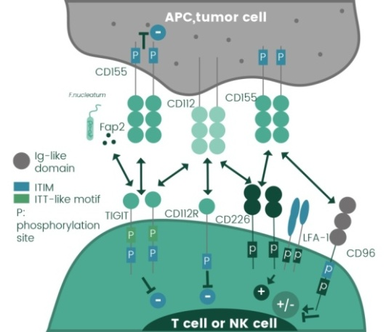
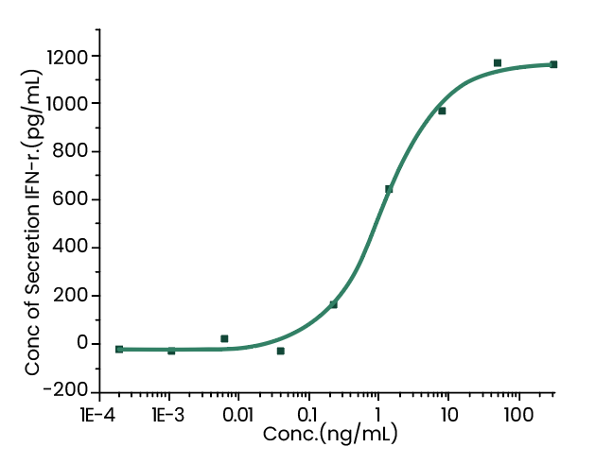
免疫检查点抑制剂
IL6
TNF-α
纯度：≥ 95 %
内毒素：＜5-10EU/mg
纯度：≥ 95 %
内毒素：＜5-10EU/mg
Cell proliferation assay using TF-1 human erythroleukemic cells.
Cytotoxicity assay using L929 mouse fibrosarcoma cells in the presence of the metabolic inhibitor actinomycin D.
IL1b
The TIGIT/CD226/CD96/CD112R axis^{[1]}
在激活受体 CD226 的丧失会抑制 CD8⁺ T 细胞功能和 ICB 功效的研究中，单核细胞衍生的成熟树突细胞被用作CD226–CD8⁺ T 细胞增殖的刺激物^{[2]}。
Monocyte-Derived Mature Dendritic Cells的制备
从PBMCs中用CD14⁺beads分离出Monocytes
培养 CD14⁺ cells的培养基中加入了GM-CSF (100 ng/ml) 和 IL-4 (50 ng/ml)，培养5天.
之后的两天需要加入TNF-α (50 ng/ml), IL-1β (50 ng/ml) and IL-6 (50 ng/ml)
成熟的DC 细胞可以用于后续的功能实验
Induce Interferon gamma secretion by human natural killer lymphoma NK-92 cells.
纯度：≥ 95 %
内毒素：＜5-10EU/mg
[1] Joe-Marc Chauvin and Hassane M. Zarour, “TIGIT in Cancer Immunotherapy,” Journal for ImmunoTherapy of Cancer 8, no. 2 (September 1, 2020): e000957, https://doi.org/10.1136/jitc-2020-000957.
[2] Marianne Weulersse et al., “Eomes-Dependent Loss of the Co-Activating Receptor CD226 Restrains CD8+ T Cell Anti-Tumor Functions and Limits the Efficacy of Cancer Immunotherapy,” Immunity 53, no. 4 (October 13, 2020): 824-839.e10, https://doi.org/10.1016/j.immuni.2020.09.006.
义翘神州

Slide 18

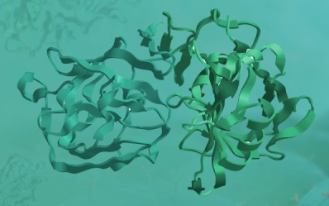
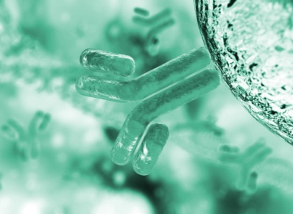
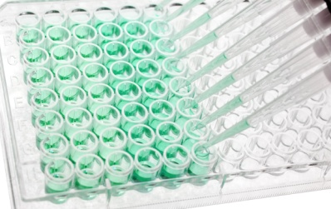





One-stop Reagent and CRO Service Provider
Catalog products: genes, recombinant proteins, antibodies, all in stock.
32,000+ Genes
6,500+ Proteins
14,000+ Antibodies
600+ ELISA Kits & Pair Sets
CRO services:
Antibody Drug Discovery：
Hit Characterization
Lead Optimization
Biological Process Intervention
义翘神州

Slide 19

期待合作，携手前行！
地址：北京市经济技术开发区科创十街18号院9号楼
北京义翘神州科技股份有限公司
义翘神州

