Slide 1
NCE 2 Lesson 23
A new house

Slide 2
New words aNd expression
complete /kəmˈpliːt/ v. 完成
modern /ˈmɑːdə(r)n/ adj. 新式的，与以往不同的
strange /streɪndʒ/ adj. 奇怪的
district /ˈdɪstrɪkt/ n. 地区

Slide 3

complete
complete /kəmˈpliːt/ v. 完成
E.g. She completed the homework yesterday.
她昨天把作业写完了。

Slide 4
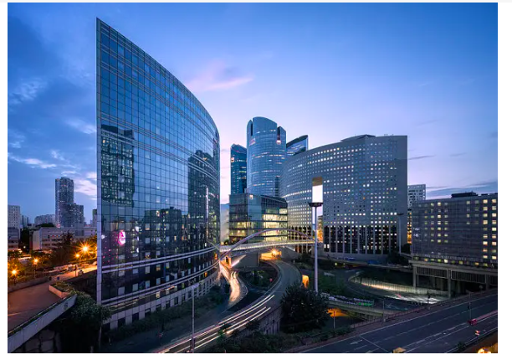
modern
modern /ˈmɑːdə(r)n/ adj. 新式的，
与以往不同的
E.g. There are many modern building in the downtown area.
市中心有许多新式的建筑。

Slide 5
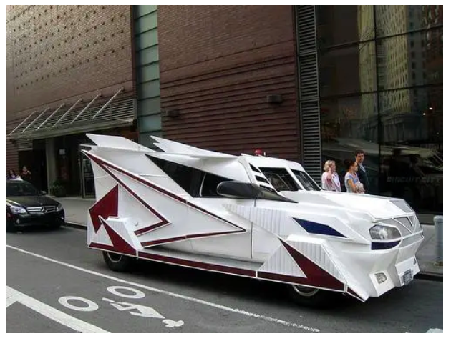
strange
strange /streɪndʒ/ adj. 奇怪的
E.g. It is a strange looking car.
这台车样式挺奇怪的。

Slide 6
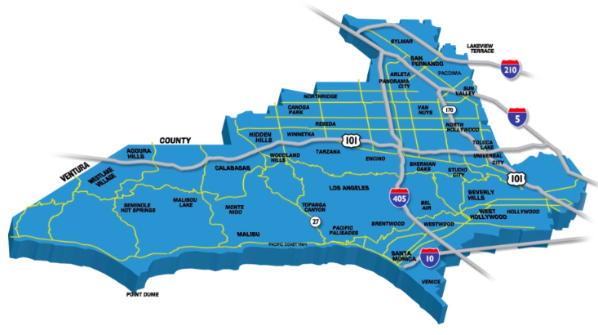
district
district /ˈdɪstrɪkt/ n. 地区
E.g. The address is XX Street, XX district, Shenyang, China.
地址是中国沈阳市XX区XX街。

Slide 7
Why is the new house special?

Slide 8
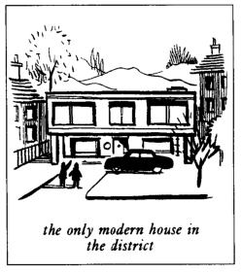
Text
get a surprise中的,suprise这里作“使人惊奇、意外的事物”解，是可数名词。
I had a letter from my sister yesterday. She lives in Nigeria. In her letter, she said that she would come to England next year. If she comes, she will get a surprise. We are now living in a beautiful new house in the country. Work on it had begun before my sister left. The house was completed five months ago. In my letter, I told her that she could stay with us. The house has many large rooms and there is a lovely garden. It is a very modren house, so it looks strange to some people. It must be the only modern house in the district.
Work on it had begun...，住宅的建设在.......就开始了。work是名词，作主语, it指房屋。
The house has many large rooms and there is a lovely garden. 这栋房子里有许多房间，还有一个漂亮的花园。there be 结构
在第一册42-44课中出现过，用来说明某处有某物。

Slide 9
参考译文
昨天我收到了姐姐但一封信，她住在尼日利亚。在信中她说她明年将到英国来。如果她来了，她会感到非常惊奇到。我们现在住在乡间到一栋漂亮到新住宅里。这栋房子在我姐姐离开之前就已动工了，是在5个月以前竣工到。我在信中告诉她，她可以和我们住在一起。这栋房子里有许多房间，还有一个漂亮的花园。它是一栋非常现代化的住宅，因此在有些人看来很古怪。它肯定是这个地区唯一的一栋现代化住宅。

