Slide 1
第四节 译林版七年级下册
Units 1—4
01
考点解读
考点梳理
02
03
真题剖析
04
实战提分

Slide 2
考点解读
01

Slide 3
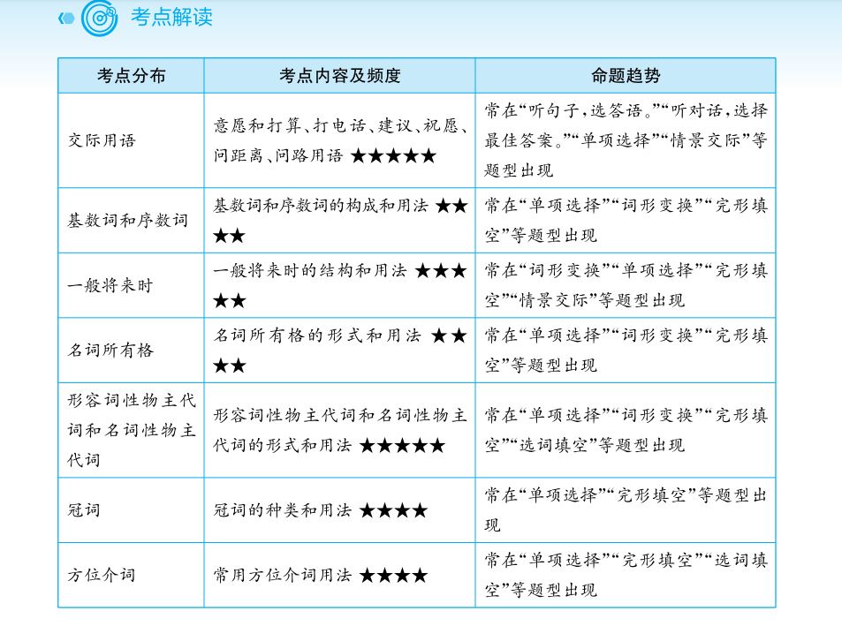

Slide 4
考点梳理
02

Slide 5
（一）常用短语
1. next to紧邻 ★★
2. living room起居室 ★★
3. share sth with sb分享某物 ★★
4. dining room餐厅 ★★
5. be full of满是 ★★★
6. of one's own属于某人自己的 ★★
7. some day将来有一天 ★★★
8. take a message捎个口信 ★★★

Slide 6
（一）常用短语
9. wash machine洗衣机 ★★
10. at the foot of在……脚下 ★★★
11. football field足球场 ★★
12. home cinema家庭影院 ★★
13. help sb with sth 帮助某人解决某种困难 ★★★★
14. do some shopping买东西 ★★★★★
15. the day after tomorrow后天 ★★★★
16. make a fire生火 ★★
17. office worker办公室职员 ★★★

Slide 7
（一）常用短语
18. police station警察局 ★★★
19. post office邮局 ★★★
20. by train/bus/ship/bike乘火车/公交车/轮船/自行车 ★★★★
21. wait a minute等一会儿 ★★★★
22. look forward to期待 ★★★★★
23. all over到处 ★★★

Slide 8
（一）常用短语
24. have to不得不 ★★★★
25. all day long整天 ★★★
26. work of art艺术品 ★★
27. northeast东北方 ★★★
28. traffic lights红绿灯 ★★
29. prepare... for... 为……准备…… ★★★★
30. plenty of大量，足够 ★★★★

Slide 9
（二）重点句型
1. I'd like to live next to a restaurant. 我想住在餐馆旁边。 ★★
2. I share a bedroom with my sister. 我和我姐姐共用一间卧室。 ★★
3. The CN Tower is 1,815 feet tall. 加拿大国家电视塔有1815英尺高。 ★★
4. Women's Day is on the eighth of March. 三月八日是妇女节。 ★★★

Slide 10
（二）重点句型
5. He always the first to come to school in our class. 他总是我们班第一个来学校的。 ★★★
6. May I speak to Daniel, please?我能和丹尼尔说话吗？ ★★★★
7. Can I take a message? 我能留个口信吗？ ★★★★
8. Can you ask him to call me back? 你能让他给我回个电话吗？ ★★★★

Slide 11
（二）重点句型
9. I'm going to visit our new neighbours. 我要去拜访我们的新邻居。 ★★★
10. They help us with all kinds of problems. 他们帮助我们解决各种问题。 ★★★★
11. There is something wrong with my computer. 我的电脑有点问题。 ★★★
12. I am going to ask a computer engineer to check it. 我要让电脑工程师检查一下。 ★★★

Slide 12
（二）重点句型
13. Some college students are ready to help. 有些大学生愿意帮忙。 ★★
14. What are you going to do in the future?你将来打算做什么？ ★★★★
15. I am going to be a computer engineer. 我要成为一名电脑工程师。 ★★★★
16. It takes only 40 minutes by underground. 坐地铁只要40分钟。 ★★★★

Slide 13
（二）重点句型
17. Why not visit our local theatre and enjoy Beijing opera. 为什么不去我们当地的剧院欣赏京剧呢。 ★★★
18. I think we have to go up again. 我想我们得再上去一次。 ★★★
19. Go straight on, and youll find the Panda House. 一直往前走，你会找到熊猫馆。 ★★★★
20. Walk along the road. To the north of the Panda House, youll find the lions. 沿着路走，在熊猫馆的北面，你会看到狮子。 ★★★★

Slide 14
（二）重点句型
21. Turn left, and to the west of the Lions Area, you'll find the world of Birds. 向左转，在狮子区的西边，你会看到鸟的世界。 ★★★★
22. Where are we going for our class trip?我们的班级旅行要去哪里？ ★★★
23. How will we get there?我们怎么去那里？ ★★★★★
24. We will get there by bus. 我们坐公共汽车去。 ★★★★★

Slide 15
（二）重点句型
25. Would you like to come? 你想一起来吗？ ★★★★★
26. Which way should I go at the traffic lights?在红绿灯那边我该走哪条路？ ★★★★
27. Have a nice trip! 旅途愉快！ ★★★★★
28. Take the second turning on the right. 在第二个路口右转。 ★★★★★
29. Turn left at the first crossing. 在第一个十字路口左转。 ★★★★★
30. I am looking forward to seeing you at the party. 我很期待在派对上见到你。 ★★★★★

Slide 16
（三）考点知识精讲
1. 交际用语
在Unit1-4中，常用的交际用语有：意愿和打算、打电话、建议、祝愿、问距离、问路等用语。例如：
（1）—Would you like to go to the movies tonight? 你今晚想去看电影吗？
—Yes, I’d love to. 是的，我很乐意。(意愿)
（2）—Hello. May I speak to Jim, please? 你好，我能和吉姆说话吗？
—Sorry, he is not at home. 对不起，他不在家。(打电话)

Slide 17
（三）考点知识精讲
（3）—Shall we take them to the cinema? 我们要带他们去看电影吗？
—Sure. 当然。(建议)
（4）—Have a nice trip! 旅途愉快！
—Thank you. 谢谢你。(祝愿)
（5）—How far is it from the hotel? 离酒店有多远？
—It's about 40 minutes by bus. 坐公交车大概要40分钟。(问距离)
（6）—Excuse me. How can I get to the station? 不好意思。我怎么去车站？
—Walk along the street, and you will see it on your left. 沿着街道走，你会看到它在你的左边。(问路)

Slide 18
（三）考点知识精讲
2. 基数词和序数词
数词分基数词和序数词。基数词表示数量，通常用来谈论数量的多少。序数词表示顺序，通常用来谈论日期、楼层、位置等。一般的序数词的构成是在基数词词尾加上th，而first、second、third是特殊的，以ve结尾的基数词，ve要变为f，再加th，如：five—fifth；twelve—twelfth，以ty结尾的基数词，y要变为ie，再加th，如：twenty—twentieth; thirty—thirtieth。十位或百位的基数词，只将其个位上的基数词变为序数词。如：fifth -five—fifth-fifth。

Slide 19
（三）考点知识精讲
3. 一般将来时
一般将来时构成：一般将来时由“助动词will+动词原形”构成，在书面语中，主语为I和we时，常用“助动词shall+动词原形”的形式。
一般将来时的用法：表示将要发生的动作或存在的状态，常与tomorrow，the day after tomorrow，next week，in a few days等表示将来的时间状语连用。例如：I will go shopping tomorrow. 我明天去买东西。
表示将来经常或反复发生的动作。例如：They will go to the park every Sunday. 他们将每周日去公园。
一般将来时态的其他表示方法：“be going to+动词原形”，表示即将发生或打算、计划、决定要做的事，或可能要发生的事。例如：We are going to spend my summer holiday in Beijing. 我们打算去北京度暑假。
有些表示位置移动的动词（如come，go，leave，return等），可用现在进行时表示按计划即将进行的动作。例如：The bus is coming in two minutes. 公交车两分钟后来。

Slide 20
（三）考点知识精讲
4. 名词所有格
名词所有格通常用来表示人或物的所有关系。单数名词的所有格式是在其后加’s。姓名的所有格形式是在其后加’s。以s或es结尾的复数名词的所有格是在其后加’s。不以s或es结尾的不规则变化的名词复数，其所有格是在后面加’s。例如：
（1）the woman’s son 这个妇女的儿子。
（2）Amy’s book 艾米的书。
（3）the teachers' office 教师们的办公室
（4）the People's Republic of China 中华人民共和国

Slide 21
（三）考点知识精讲
5. 形容词性物主代词和名词性物主代词
形容词性物主代词和名词性物主代词通常用来表示人或物的所有关系。形容词性物主代词后一般带有名词。名词性物主代词相当于“形容词性物主代词+名词”。it没有名词性物主代词。例如：
（1）This is his father. 这是他的父亲
（2）The computer is mine. 这台电脑是我的。
形容词性物主代词和名词性物主代词归纳如下：
 | 单数 |  |  |  |  | 复数
 | 第一人称 | 第二人称 | 第三人称 |  |  | 第一人称 | 第二人称 | 第三人称
形容词性物主代词 | my | your | his | her | its | our | your | their
名词性物主代词 | mine | yours | his | hers | / | ours | yours | theirs

Slide 22
（三）考点知识精讲
6. 冠词
冠词分为不定冠词和定冠词。不定冠a/an 常用来泛指某人或某物，定冠词the 常用来指特定的某人或某物。a用于以辅音音素开头的单词前，an用于以元音音素开头的单词前，注意不是以元音字母开头，因为有些以元音字母开头的单词并不以元音发音的。一般在一日三餐、球类运动和学科名词前不加冠词，在乐器名称前加定冠词。例如：
（1）A boy is waiting for you in the classroom. 教室里有个男孩在等你。
（2）He is an honest man. 他是个诚实的人。
（3）She doesn’t like play football, but she likes play the violin. 她不喜欢踢足球，但她喜欢拉小提琴。

Slide 23
（三）考点知识精讲
7. 方位介词
方位介词常用来表示物体的位置。常用的方位介词有at, in, on, above, below, over, under, in front of, behind, between 等。例如：
（1）There are some books on the desk. 桌子上有些书。
（2）There is a big tree behind my house. 我家后面有棵大树。
8. look out
look out意为“向外看”。look out at sth 意为“向外看某物”，at 后接看的具体内容。look out of意为“向……外看”。look out还意为“小心，当心”。例如：
（1）Look out at the girl. She is playing happily. 看外面的女孩，她玩得很开心。
（2）Don't look out of the window! 别往窗外看！
（3）Look out! The bus is coming. 小心，公交车来了。

Slide 24
（三）考点知识精讲
9. ask sb to do sth
ask sb to do sth意为“要求某人做某事”，其中动词不定式作宾语补足语。例如：
He asked me to help him with his English. 他要求我帮他学英语。
10. bring与take
bring作为动词，意为“带来”。bring的对应为take（带走）。例如：
（1）Bring your computer here tomorrow. 明天把你的电脑带过来。
（2）Take the chair to the hall, please. 请把椅子搬到大厅去。

Slide 25
（三）考点知识精讲
11. make
make意为“使，让”，后接名词、形容词、省略to的动词不定式作宾语补足语。例如：
（1）My father often makes me get up early every day. 我父亲经常让我每天早起。
（2）We should make our hometown beautiful. 我们应该让我们的家乡变得美丽。
12. look, see, read与watch
look强调看的动作，常与at 连用。see强调看的结果，意为“看到”。read则重“阅读”。watch强调看过程，常用于看电视、看比赛等。例如：
（1）Please look at the blackboard and listen to me. 请看黑板，听我说。
（2）Can you see it clearly? 你能看清楚吗？
（3）I like reading story books. 我喜欢看故事书。
（4）I was watching TV at eight last night. 昨晚八点我在看电视。

Slide 26
（三）考点知识精讲
13. look forward to
look forward to是固定短语，意为“盼望，期盼”，介词to后接名词或动词ing形式。例如：
I am looking forward to meeting my old friend soon. 我期待能尽快见到我的老朋友。
14. between与among
between和among作方位介词，意为“在……之间”，between表示两者之间，among表示三者或三者以上之间。例如：
（1）Tom sits between Lily and Lucy. 汤姆坐在莉莉和露西中间。
（2）He is standing among a crowd of children. 他站在一群孩子中间。

Slide 27
（三）考点知识精讲
15. plenty of
plenty of为固定短语，意为“大量，足够”，既可修饰可数名词也可修饰不可数名词，一般用于肯定句中。例如：
（1）We have plenty of eggs. 我们有很多鸡蛋。
（2）He has plenty of time to finish his homework. 他有足够的时间完成作业。

Slide 28
真题剖析
03

Slide 29
真题链接
【例1】（2020年昆明）—Hello, may I speak to Gina?
— ________.
A. Hi, this is Gina speaking B. Hi, I’m Gina
C. May I know your address D. May I take a message for you
【例2】（2020年毕节）His office is on the top of the tall building. You should take a lift to the ________floor.
A. First B. thirtieth C. thirty D. thirteen
✓
【解析】考查打电话的交际用语。根据句意可知答语应用“This is sb speaking. ”。故选A。
✓
【解析】本题考查序数词的用法。根据句意“他的办公室在这座大楼顶层”和表示楼层是用序数词可知 thirtieth是正确的。故选B。

Slide 30
真题链接
【例3】（2020年江苏）Our teacher a bookshelf at the back of our classroom to make a small reading corner.
A. picked up B. put up C. took up D. got up
✓
【解析】正确答案：B。A是拾起、捡起，B是张贴、建立，C是从事，占据，D是起床。根据句意可知为了做一个小阅读角，我们的老师就在教室后面建了一个书架，故选择B。
【例4】（2020年广西北部湾经济区）—Look at the umbrella. Whose is it?
—It may be Millie's. umbrella is the same as this one.
A. She B. Her C. Hers D. Herself
✓
【解析】考查形容词性物主代词。根据问句“Whose is it?”可知此处是询问谁的雨伞。形容词性物主代词后一般带有名词。故选B。

Slide 31
真题链接
【例5】（2019年广西北部湾经济区）—I usually have egg and some bread for breakfast.
A. a B. an C. the D. /
✓
【解析】考查冠词的用法。a用于以辅音音素开头的单词前，an用于以元音音素开头的单词前，单词egg 是以元音音素开头的单词。故选B。
【例6】（2020年天水）Lily is a friend of .
A. Mary's mother's B. Mary's mother's of
C. Mary mother's D. mother's of Mary
✓
【解析】考查名词所有格。根据句意可知此处应用双重所有格。故选A。

Slide 32
真题链接
【例7】（2020年百色）Hong Kong is the south of China, its one of the busiest cities in the world.
A. in B. on C. at D. to
【解析】考查方位介词。句意：香港位于中国的南部，它是世界上最繁华的城市之一。根据常识可知香港属于中国，用介词in。故选A。
【例8】（2020年武汉）—Is Helen here?—Not yet, but she in half an hour.
A. arrives B. will arrive C. arrived D. has arrived
【解析】考查动词时态。根据“Not yet”可知她还没到达，根据“in half an hour”可知是将来时间，动词应用一般将来时。故选B。
✓
✓

Slide 33
易错剖析
【例1】My uncle is honest man.
A. a B. an C. the D. /
【解析】此题容易误选A。本题考查冠词的用法。冠词a用于以辅音音素开头的单词前，冠词an用于以元音音素开头的单词前，本句中的honest是元音音素开头的单词, honest 中的h 不发音。故选B。
✓

Slide 34
实战提分
04

Slide 35
基础过关
（一）单词检测。根据中文意思，写出下列单词。
1. 皇宫____________ 2. 城镇___________
3. 首都____________ 4. 百____________
5. 服务员____________ 6. 工程师____________
7. 修理____________ 8. 本地的____________
9. 新鲜的____________ 10. 危险的____________
palace
town
capital
hundred
town
engineer
fix
local
fresh
dangerous

Slide 36
基础过关
（二）短语回顾。根据中文或英文表达，翻译下列短语。
1. 后天______________ 2. 期待______________
3. 不得不______________ 4. 大量______________
5. 买东西______________
6. take a message______________
7. worry about______________
8. next to______________
9. be full of______________
10. police station______________
the day after tomorrow
look forward to
have to
plenty of
do some shopping
捎个口信，带话
担忧
紧邻
满是
警察局

Slide 37
拓展提升
（一）单词拼写。根据括号内所给的中文提示，正确拼写单词。
1. This is his book. __________ (我的) is on my desk.
2. I am __________ (幸运的) to live in a neighbourhood like that.
3. If you want to learn more about Chinese art, don’t _______(错过) the opera shows there.
4. His father is a __________ (著名的) doctor.
5. Tell the kid it is __________（危险的）to play with fire.
（二）词形变换根据句意。用括号中所给单词的正确形式填空。
1. Tom __________ (play) football tomorrow afternoon.
2. I’m looking forward to__________ (show) them around the museum.
3. Women’s Day is on the _______ (eight) of March.
4. Today is June 1. It’s __________ (children) Day.
5. These books are _______ (we).
mine
lucky
miss
famous
dangerous
will play
showing
eighth
Children’s
ours

Slide 38
拓展提升
（三）单项选择。从下列每小题所给的选项中，选出可以填入空白处的最佳选项。
1.（ 2020年自贡）—A boy is flying a kite over there. Who is he?
—Oh, he is ________ brother.
A. Lucy’s and Lily’s B. Lucy and Lily’s C. Lucy’s and Lily
2.（2020年重庆）Teachers’ Day is in September, the ________ month of the year.
A. nine B. ninth C. ten D. tenth
3.（ 2020年岳阳）The family photos aren't in ________ room, it must be in ________.
A. my; his B. his; my C. me; his
✓
✓
✓

Slide 39
拓展提升
4.（2020年湘西）I enjoy having ________ breakfast with my family at home. It makes me feel relaxed.
A. a B. the C. /
5. （2020年龙东）Today is my little brother's ________ birthday, so I put ________ candles in the cake.
A. eight; eighth B. eighth; eight C. eight; eight
6.（2020年河北）When are arriving? I will pick you up ________ the station.
A. at B. to C. on D. off
✓
✓
✓

Slide 40
拓展提升
7. （2020年临沂）Thanks for letting us borrow your camera. We ______ it to you next Monday.
A. return B. will return C. have returned
8. （2020年益阳）I read ______ unusual story last night. _____ story is about Dr. Zhong Nanshan.
A. an; a B. a; The C. an; The
✓
✓

Slide 41
（四）情景交际。根据对话内容，从下面方框中选出恰当的句子补全对话。
A: Excuse me, I want to go to the library. 1
B: Go down this street and turn right at the second crossing. Go up the road to the end, you'll find it.
A: 2
B: It's about 1,000 metres away from here.
A: Oh. That's quite a long way.
B: Yes. You'd better take a bus.
A: 3
B: You can take the No.5 bus. It'll take you there.
A: 4
B: It takes about fifteen minutes.
A: 5
B: It's a pleasure.
A. Which bus should I take?
B. How can I get there?
C. How long does it take me to get there?
D. Thank you very much.
E. How far is it from here?
答案：BEACD

Slide 42
（五）选词填空。根据短文内容，从方框中选择恰当的单词填空，并将单词填在短文后横线上。每个单词只能用一次，每空一词。
old nice lives interesting studies books sports songs helps from
Mr Green is a good teacher. He often 1 us with our lessons. And he is 2 to every student. His lessons are very 3 . We usually have fun in his lessons. We all like him. He says he is 40 years 4 . But he looks very young. He comes 5 New York. Now he 6 in Nanjing with his family. He has a daughter. She is a pretty girl. And she 7 in our school too. Mr Green can sing many English 8 . We all like to listen to him singing. He also likes 9 . He is in the school basketball team. Mr Green likes reading. We often borrow 10 from him. I think we are lucky to have Mr Green to teach us.

Slide 43
1._______ 2.________ 3.__________4.________5.__________
6._______ 7.________ 8.__________9.________10._________
helps
nice
interesting
old
from
lives
studies
songs
sports
books

