Slide 1
第一章
夯实基础过教材——分册复习
第四节 八年级（下）

Slide 2
What’s the matter?
Units 1

Slide 3
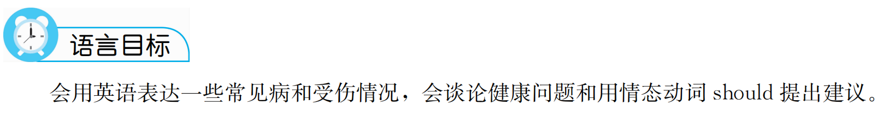

Slide 4
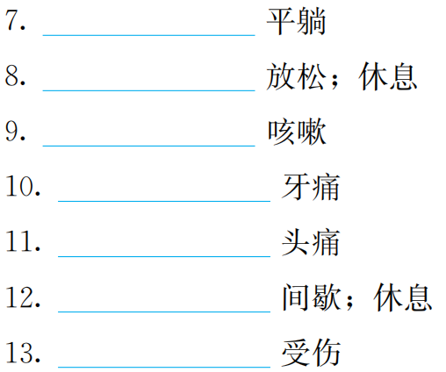
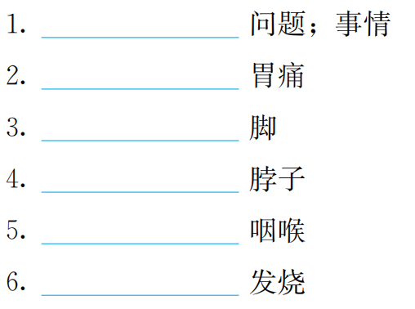
重点单词
lie
matter
rest
stomachache
cough
foot
toothache
neck
headache
throat
break
fever
hurt

Slide 5
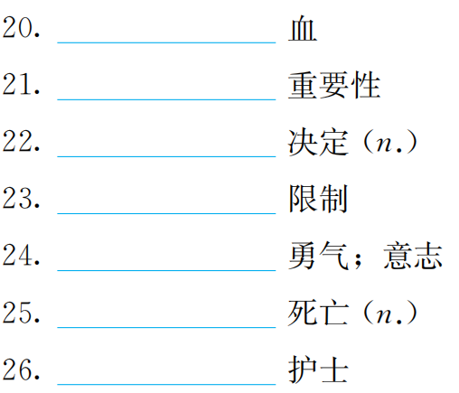
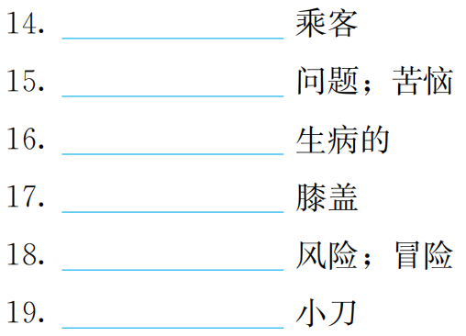
blood
passenger
importance
trouble
decision
sick
control
knee
spirit
risk
death
knife
nurse

Slide 6
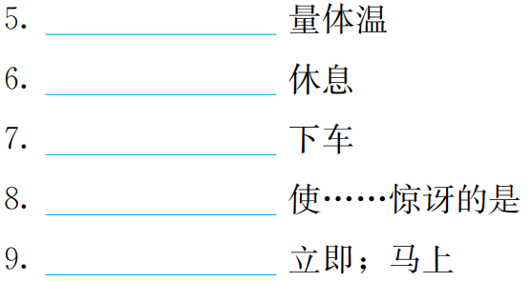
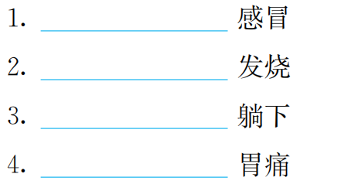
重点短语
take one's temperature
have a cold
take breaks
have a fever
get off
lie down
to one's surprise
have a stomachache
right away

Slide 7
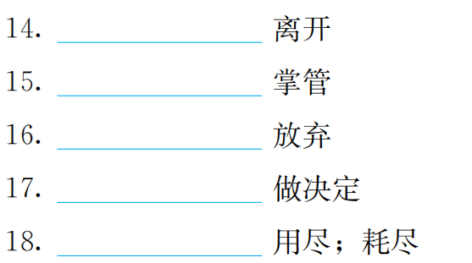
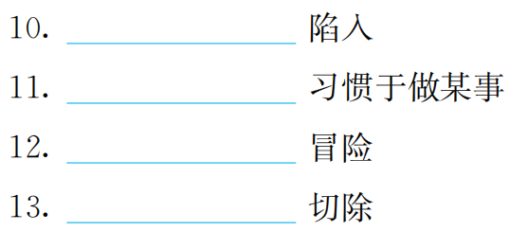
get out of
get into
be in control of
be used to doing sth.
give up
take risks
make a decision
cut off
run out（of）

Slide 8
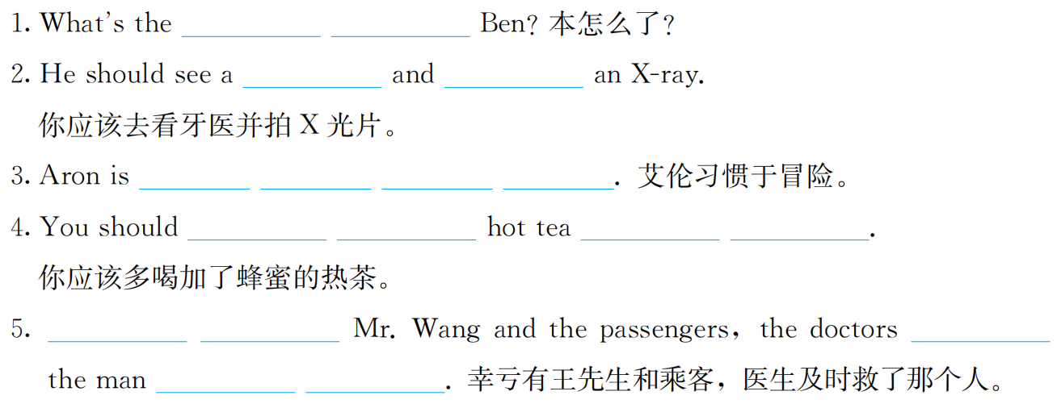
重点句型回顾及情景交际
matter
with
dentist
get
used to taking risks
drink more
with honey
Thanks to
saved
in
time

Slide 9
语法精要
话题

Slide 10
巩固练习

Slide 11
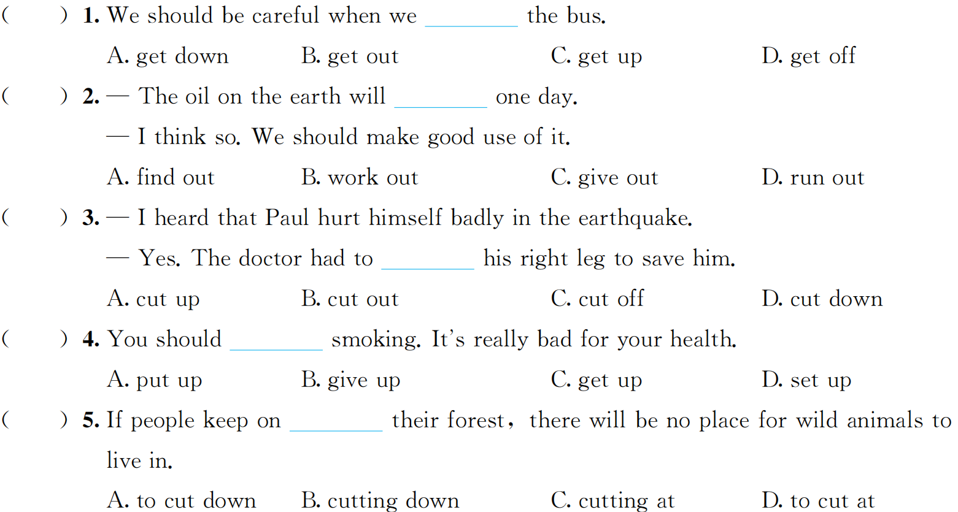
一、单项选择
D
D
C
B
B

Slide 12
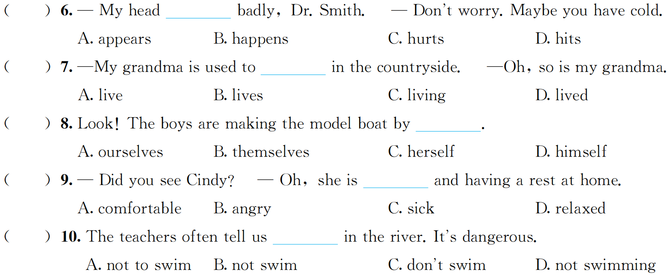
C
C
B
C
A

Slide 13
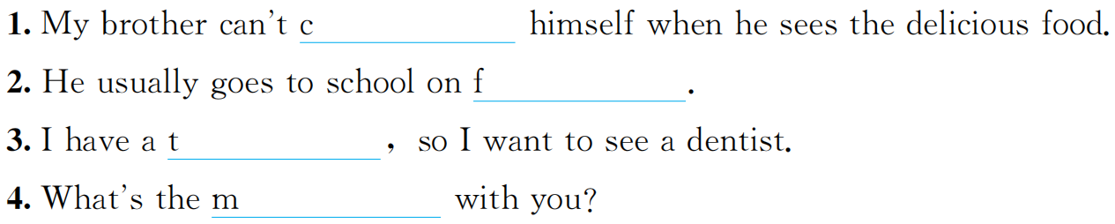
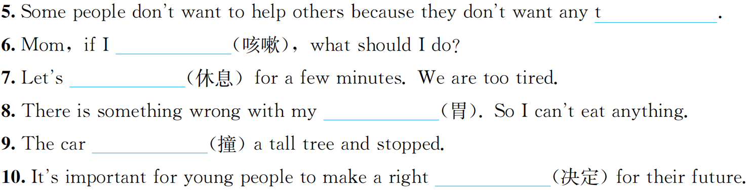
二、单词拼写
ontrol
oot
oothache
atter
rouble
cough
rest
stomach
hit
decision

Slide 14
I’ll help to clean up the city parks.
Units 2

Slide 15
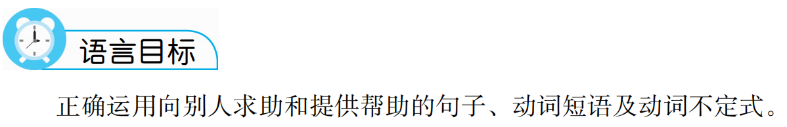

Slide 16
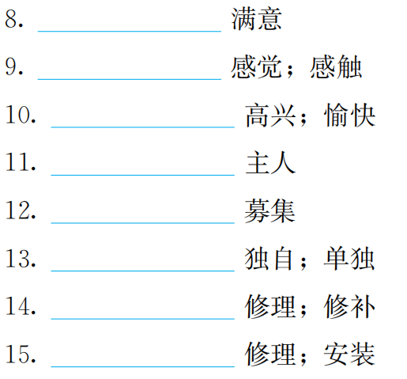
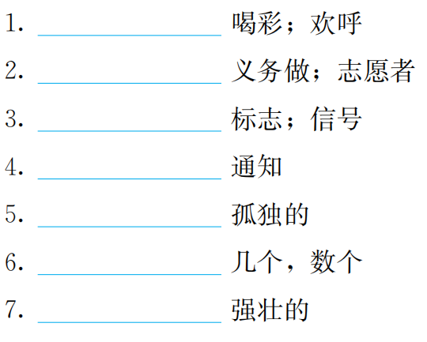
重点单词
satisfaction
cheer
feeling
volunteer
joy
sign
owner
notice
raise
lonely
alone
several
repair
strong
fix

Slide 17
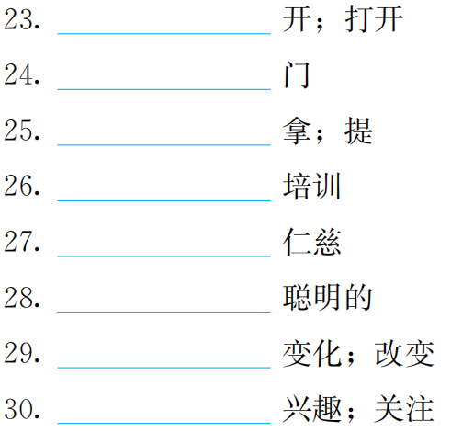
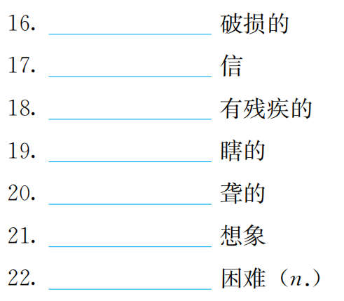
open
broken
door
letter
carry
disabled
train
blind
kindness
deaf
clever
imagine
change
difficulty
interest

Slide 18
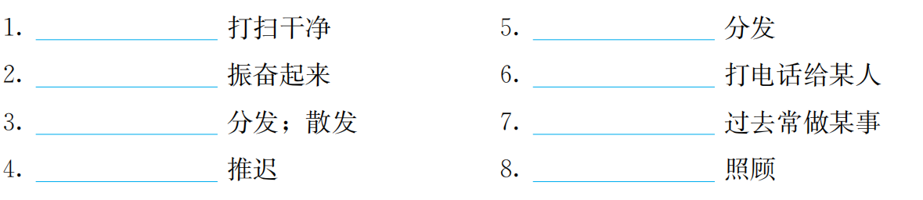
重点短语
clean up
hand out
cheer up
call up
give out
used to do
put off（doing）sth.
care for

Slide 19
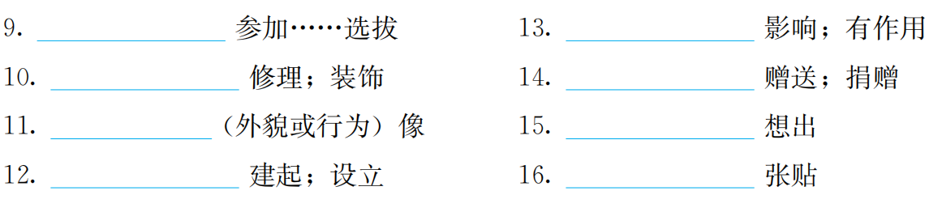
try out
make a difference
fix up
give away
take after
come up with
set up
put up

Slide 20
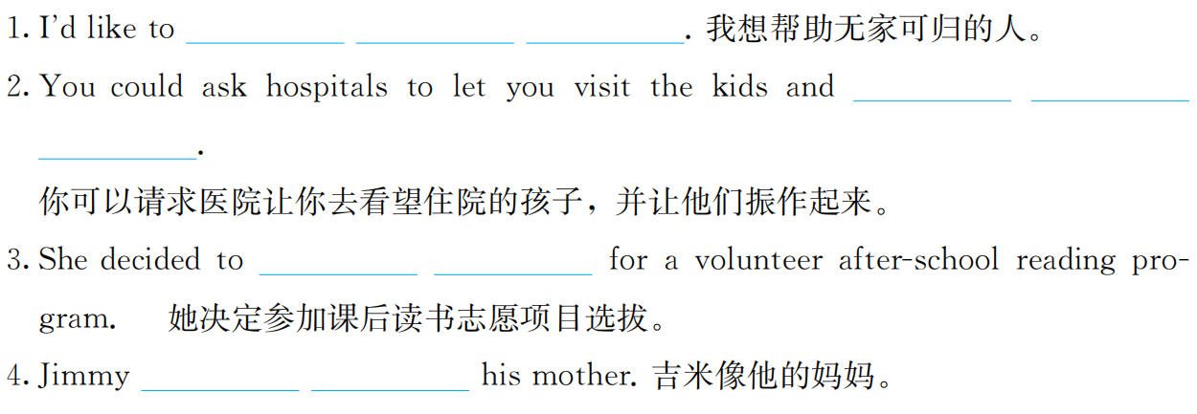
重点句型回顾及情景交际
help
homeless
people
cheer
them
up
try
out
takes
after

Slide 21

语法精要
话题

Slide 22
巩固练习

Slide 23
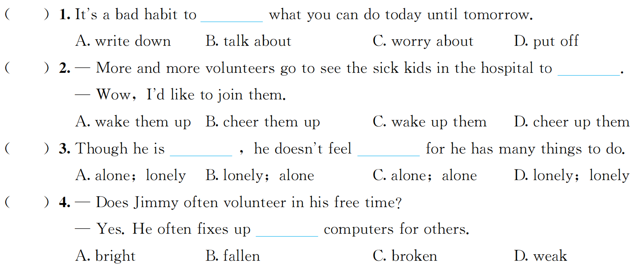
一、单项选择
D
B
A
C

Slide 24
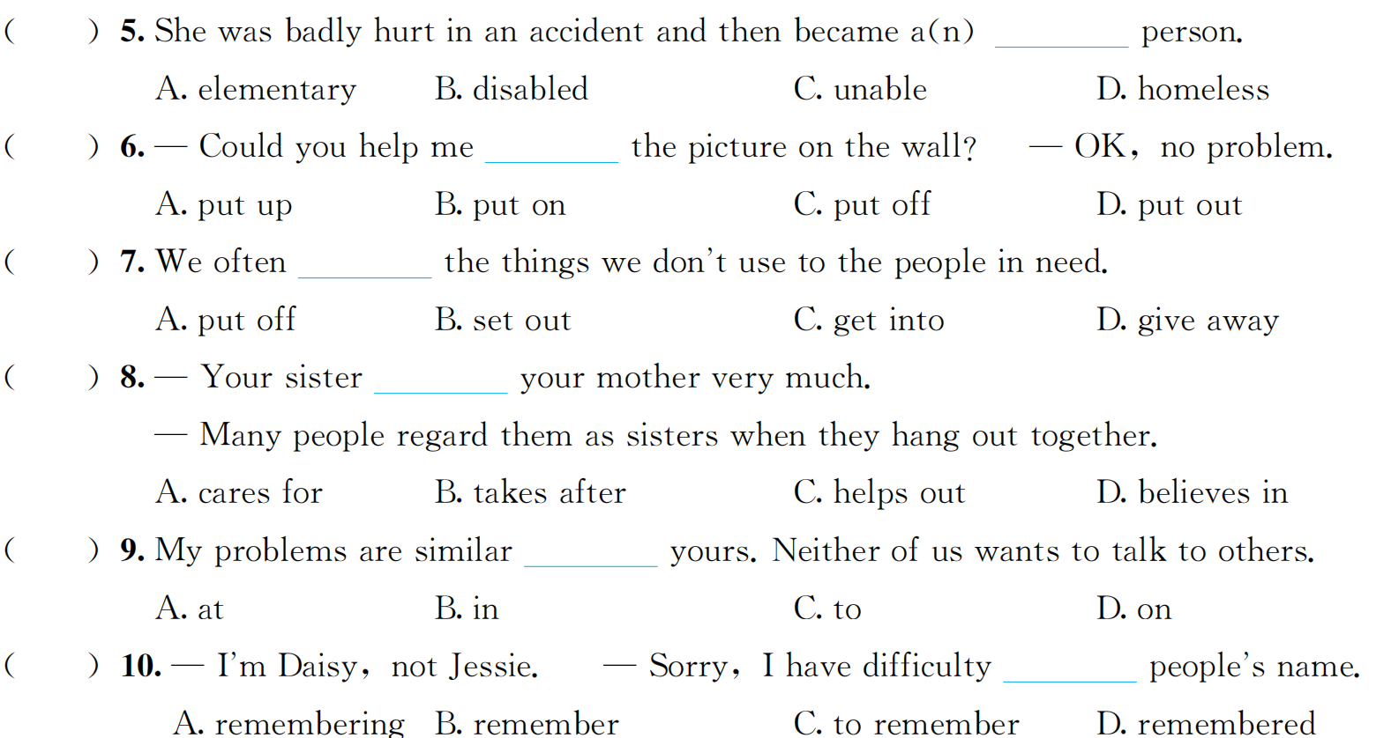
B
A
D
B
C
A

Slide 25
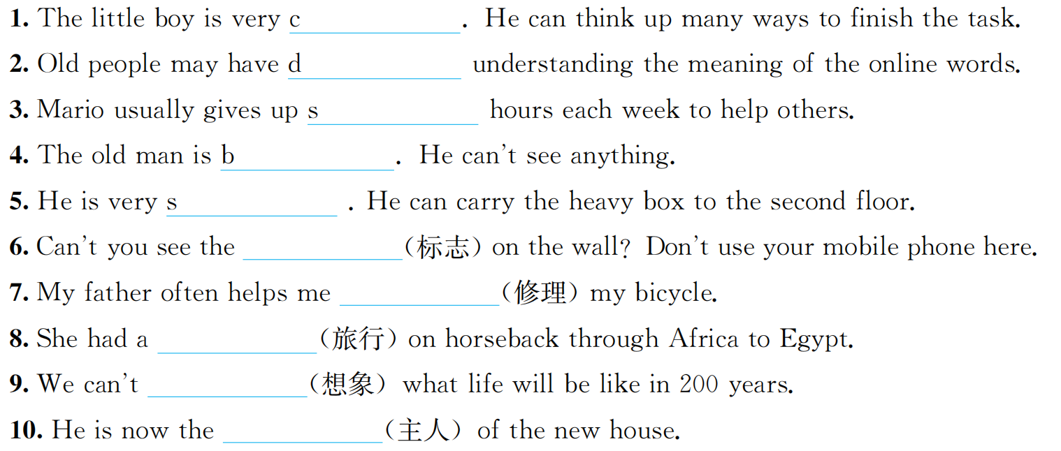
二、单词拼写
lever
ifficulty
everal
lind
trong
sign
fix
journey
imagine
owner

